Slide 1
Understanding the Long-Stay QMs for Depression and Weight Loss
EQUIP Webinar
March 24, 2016
Presenters: Kathy Pellatt and Beth Webb
For Help, phone: 518-867-8390
While waiting for the webinar to begin, remember to mute your own phone line by pressing *6

Slide 2
Agenda
Provide a brief review of terms and assessments related to the long-stay measures
Define the Long-Stay Quality Measures of Depression and Weight Loss
Discuss MDS coding specific to these QMs
Generate EQUIP QM rates report and look at the residents flagging for the two QMs
List tips for identifying quality issues related to each of the measures

Slide 3

Definitions
Short Stay: An episode with Cumulative Days in The Facility (CDIF) less than or equal to 100 days as of the end of the target period
Long Stay: An episode with CDIF greater than or equal to 101 days as of the end of the target period

Slide 4
Definitions
Cumulative days in facility (CDIF): Total number of days during which the resident was in the facility.
        Days in the hospital are not counted towards the CDIF
The measures are mutually exclusive
      Only short-stay residents are looked at for the short-stay measures
      Only long-stay residents are looked at for the long-stay measures

Slide 5
Long Stay Record Definitions
Target Assessment
  Selection period - most recent 3 months (Long-Stay target period)
  Specific OBRA , PPS and discharge assessments qualify
    AO310A=(01, 02, 03, 04, 05, 06) or
    AO310B=(01, 02, 03, 04, 05) or
    A0310F=(10, 11)
  Latest assessment that is contained within the resident’s selected episode, has a qualifying reason for assessment and its target date is no more than 120 days before the end of the episode.
Notes:
Let’s go over the long-stay record definitions now. In the case of the long-stay measures, the target period is three months. As with the short-stay measures, certain OBRA, PPS, and Discharge assessments are used. They are exactly the same as the ones used for the short-stay measures. And, as with the short-stay calculations, the target assessment can be no more than 120 days before the end of the resident’s episode. In this example, the target assessment, a quarterly, is 66 days before the end of the resident’s episode which occurred on 11/5, so it will be used in the QM calculations.

Slide 6
Percent of residents who have depressive symptoms (long-stay)
  Numerator: Long-Stay residents with target assessment that meets either of the following two conditions:
    Resident Mood Interview: Resident has little interest or pleasure in doing things half or more of the days over the last two weeks (D0200A2=2,3) OR resident is feeling down, depressed or hopeless half or more days over the last two weeks (D0200B2=2,3); AND the resident interview total severity score indicates depression (D0300>=10 and <=27).
    Staff assessment of mood: Resident has little interest or pleasure in doing things half or more of the days over the last two weeks (D0500A2=2,3) OR resident is feeling or appearing down, depressed, or hopeless half or more of the days over the last two weeks (D0500B2=2,3); AND the staff assessment total severity score indicates depression (D06000>=10 and <=30)
  Denominator: All long-stay residents with a target assessment, except those with exclusions.

Slide 7
Percent of residents who have depressive symptoms (Long-Stay)
  Exclusions:
    Resident is comatose or comatose status is missing (B0100=1, -)
    The mood interview items are blank or missing on the MDS (D0200 A2, D0200B2, d0300, D0500A2, D0500B2 or D0600)

Slide 8
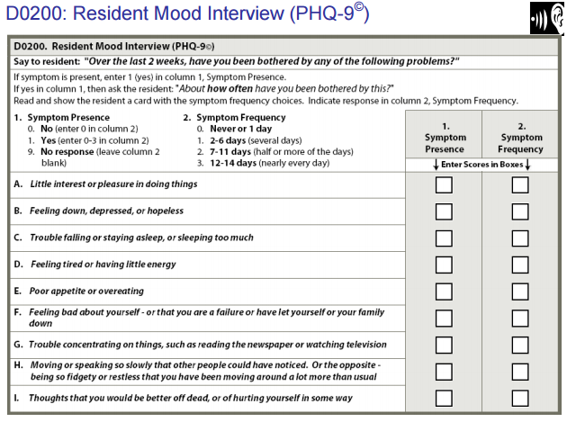
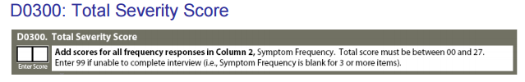
Coding Section D
Remember only two of the questions in the mood interview and the total severity score will factor into the depression quality measure

Slide 9
Coding Section D: Mood
Determine if the resident can take part in the resident interview (D0100=1)
If the resident needs an interpreter, every effort should be made to have one present
Conduct the interview the day before or day of the ARD in a private setting
Explain the reason for the interview before beginning
Each question must be asked in sequence before proceeding to the next question
For a yes response, ask the resident to tell you how often he or she was bothered by the symptom over the last 14 days. It helps to show cue cards with frequency categories described

Slide 10
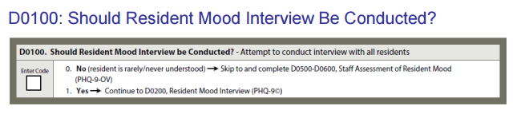
Coding Section D: Mood
If resident is unable or unwilling to complete the Resident Mood interview, staff should complete the Staff assessment of Mood
Interview staff from all shifts
The same interviewing tips and techniques described in the MDS manual should be used
Glean information from family or significant others when appropriate

Slide 11
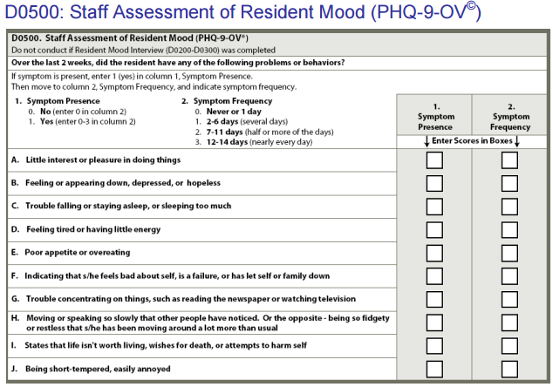

Coding Section D

Slide 12
Important to Note!
When a resident flags for the depression QM, it does not automatically mean that the resident has a diagnosis of depression or other mood disorder. It means there is a presence of specific clinical mood indicators that are important to recognize and care plan for.
The QM specifically looks at moderate to severe depressive symptoms.
If your facility rate is 0%, it doesn’t mean that you have no residents with depression. It means that there are no long stay residents with moderate to severe depressive symptoms.

Slide 13
Resident Example – Depressive Sx
Mrs. D., a long stay resident post CVA and mild dementia with a current URI
She is able to take part in the mood interview
She says she has little interest or pleasure in doing things for the past two days
She states she has been feeling depressed and down for the past two days as well
Her total severity score is 5
Will Mrs. C. flag on the Depressive Sx QM?

Slide 14
Resident Example – Depressive Symptoms
No, Mrs. D will not flag on the Depression QM
She has felt down and depressed in the past two days (not 7 or more days) and
She has had little interest in doing things for the past two days (not 7 or more days)
Her total severity score is 5 (not 10 or more), which indicates mild depression
Perhaps the assessor will want to determine if these symptoms of mild depression are due to her having an upper respiratory infection and not feeling physically well

Slide 15
Percent of residents who lose too much weight (long-stay)
  Numerator: Long-Stay residents with a target assessment indicating a weight loss of 5% or more in the last month or 10% or more in the last 6 months who were not on a physician prescribed weight loss regimen (K0300=2)
  Denominator: All long-stay residents with a target assessment except those with exclusions.

Slide 16
Percent of residents who lose too much weight
Exclusions:
  Target assessment is an admission or a PPS 5-day assessment
  Weight loss item is missing on target assessment (K0300=-)

Slide 17
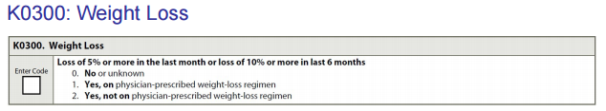
MDS Coding
For a new admission, you may have to ask the resident or family about weight loss over the past 30 and 180 days.
For subsequent assessments, compare the resident’s weight in the current observation period to his or her weight in the observation period 30 days ago and 180 days ago.
If the current weight is less than the weight in the observation period 30 days ago or 180 days ago, calculate the percentage of weight loss.
If it is a 5% loss in the last 30 days or a 10% loss in the past 180 days, and the resident is not on a planned weight loss program, code “2”.

Slide 18
Resident Example
Mr. P – a long-stay resident with dementia has required more help with eating in the last couple of months
His current weight is 177 pounds
30 days ago, his weight was 188 pounds
180 days ago, his weight was 195 pounds
Will he flag on the Weight Loss QM during this QM reporting period?

Slide 19
Resident Example
Yes, Mr. P will flag because he has lost a little more than 5% of his total weight in the past month
30 day calculation – 188 x 0.95 = 178.6. His current weight of 177 lbs. is less than the 5% point of 178.6 lbs. so he has lost 5% of his body weight
180 day calculation – 195 x 0.90 = 175.5. His current weight of 177 lbs. is more than the 10% point of 175.5 lbs., so he has not lost 10% of his body weight

Slide 20
EQUIP Website
CMS Quality Monitor and Resident Level Report

Slide 21
Live and On-Demand Webinars
  Visit: http://www.equipforquality.com/community/index.cfm/resources-and-tools/webinars/

Slide 22

Questions?
Contact information:
EQUIP e-mail box: equip@equipforquality.com
Kathy Pellatt: kpellatt@leadingageny.org
Beth Webb: bwebb@leadingageny.org
Phone: 518-867-8390

