Slide 1

Member Community

Slide 2

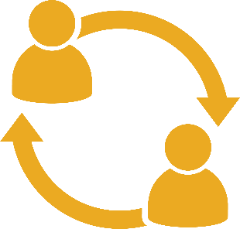


The My LeadingAge Member Community is where LeadingAge members across the country connect with one another online to . . .
Members have access to a personalized, interactive experience
that empowers them to engage year-round with their peers
in aging services.
exchange knowledge
share resources
solve problems
What is the Member Community?
Community.LeadingAge.org

Slide 3
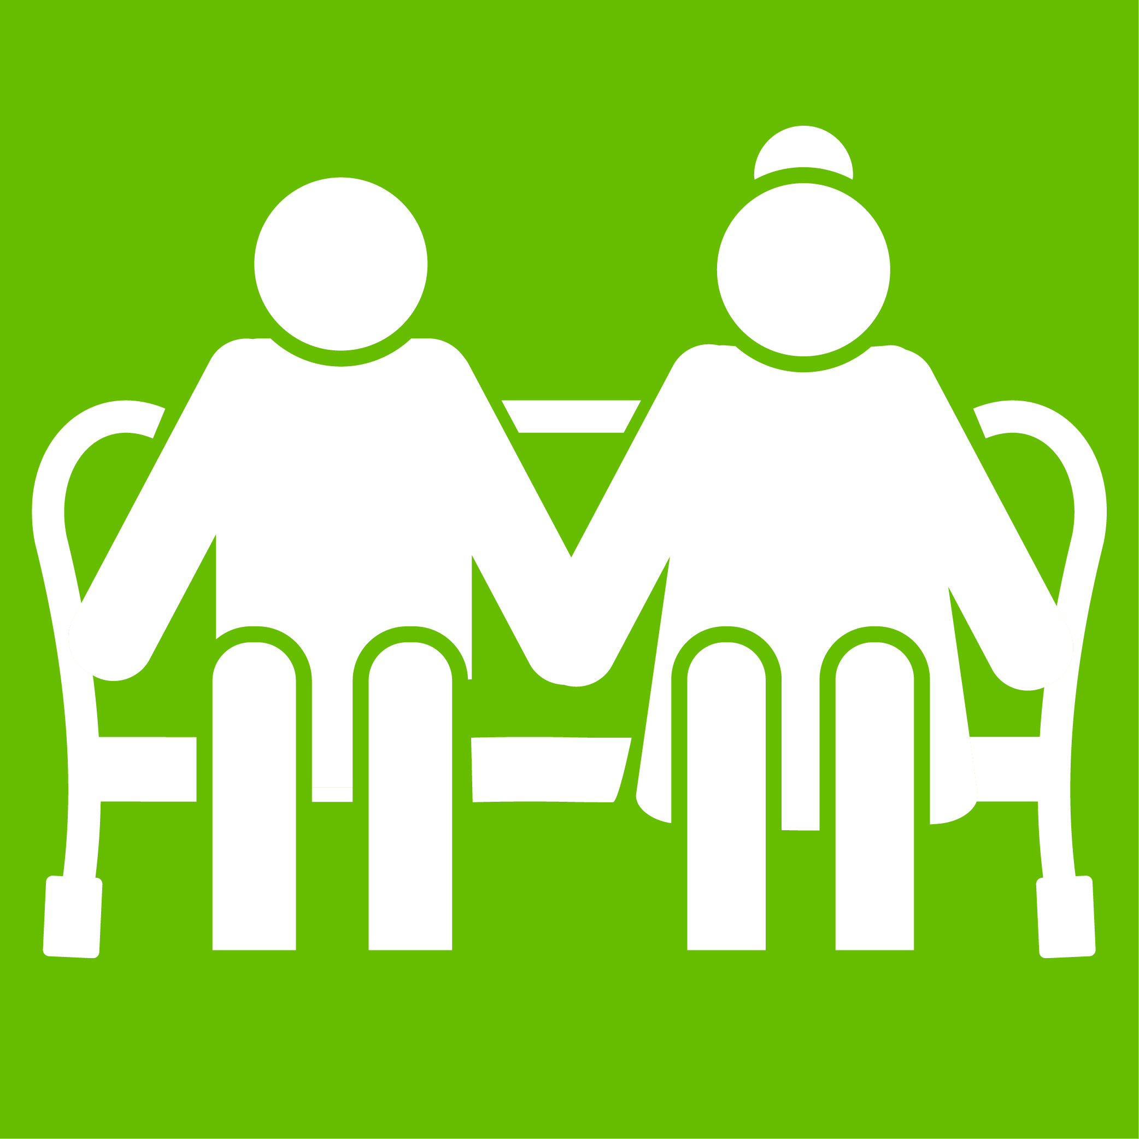









Adult Day Services (Medical & Social)
CAST/Technology
Communications Collaborative
Compliance
Continuing Care at Home (CCaH)
Corporate Alliance Program Members
Facilities Management Professionals
Governance
Holistic Wellbeing
Home & Community-Based Services
More Than 25 Groups
Community.LeadingAge.org

Slide 4










Home Health
Hospice
Housing Operations & Policy
HR/Workforce
LGBT
Life Plan Community (CCRC)
Life Plan Community (CCRC) - Single Site Providers
Living Well With Dementia
Managed Care
Marketing
More Than 25 Groups
Community.LeadingAge.org

Slide 5









Next Gen Professionals
Nursing Homes
PACE
Payroll-Based Journal (PBJ)
Philanthropy
Rural Providers
Social Accountability
Social Work
Student Program
More Than 25 Groups
Community.LeadingAge.org

Slide 6
More Than 25 Groups
Community.LeadingAge.org

Slide 7
Adult Day Services (Medical & Social)
CAST/Technology
Communications Collaborative
Compliance
Continuing Care at Home (CCaH)
Corporate Alliance Program Members
Facilities Management Professionals
Governance
Holistic Wellbeing
Home & Community-Based Services
Home Health
Hospice
Housing Operations & Policy
HR/Workforce
LGBT
Life Plan Community (CCRC)
Life Plan Community-Single Site Providers
Living Well with Dementia
Managed Care
Marketing
Next Gen Professionals
Nursing Homes
PACE
Payroll-Based Journal (PBJ)
Philanthropy
Rural Providers
Social Accountability
Social Work
Student Program
More Than 25 Groups
Community.LeadingAge.org

Slide 8
Community.LeadingAge.org

