Slide 1
ADHC Without Walls: Benefits, Barriers, and the Business of Telehealth
Candice Duffy, director, Schofield ADHC
Kathleen DiPietro, director, Middle Island West and Middle Island East ADHC
Brendan Flinn, director, HCBS policy, LeadingAge
Rola O’Meally, director, St. Ann’s Community ADHC programs

Slide 2
Introduction and Agenda
Welcome and a brief review, disclaimer
Resources available on www.adhcc.org
Tool kit to be completed and available in July
Why another webinar on telehealth?
Each panelist brings unique perspective on telehealth business
A view from national
Q&A
Notes:
Big leap for our industry; acting on good faith that we will get compensated for the work. Remember that these claims will be audited and you have to validate your service and billing. No sense of additional guidance from DOH. Consulted with lobbyists and give you the best information we can.

Slide 3
Schofield ADHC, Buffalo
Which of your staff is doing telehealth? Solid relationship with finance department
Willingness to take chances/flexibility/fluidity
Negotiation with managed care
Subjectivity/gut feeling; did services constitute payment?
  Case management
  Nutrition counseling
  Mental health support

Slide 4
Schofield ADHC, Buffalo
Continued:
  Referrals and follow ups
  Entitlements
  Coordination of transport
  Medication reviews
Documentation
Telehealth in the future

Slide 5
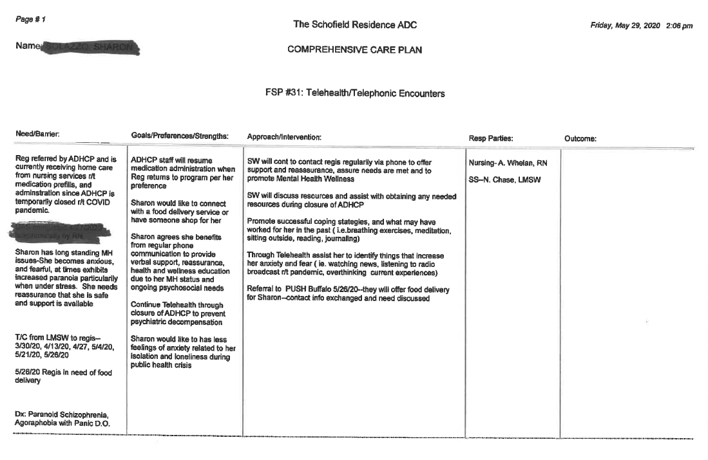
Notes:
Example objectives
At the end of this lesson, you will be able to:
Save files to the team Web server.
Move files to different locations on the team Web server.
Share files on the team Web server.

Slide 6
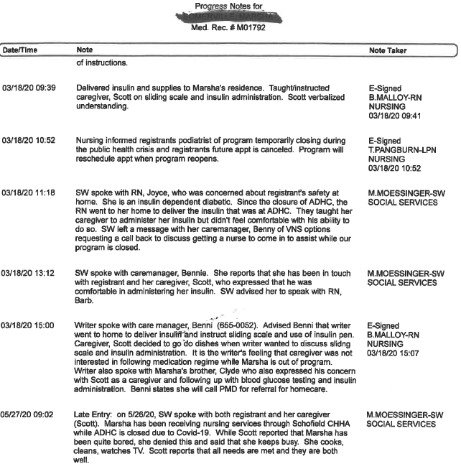

Slide 7
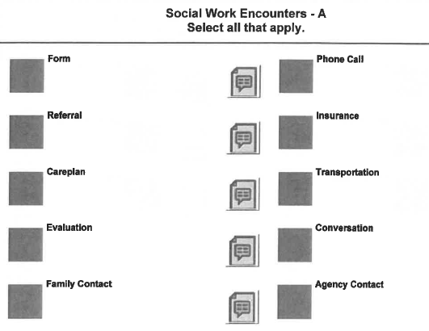

Slide 8
Adult Day Services – Pandemic Planning
Wellness Program
Rola O’Meally
Director for Adult Day and Dementia Services
St. Ann’s Community
June 18, 2020

Slide 9
St. Ann’s Adult Day Services - Overview
Located in Rochester, NY – St. Ann’s Community provides Adult Day Services at 3 sites
    Durand – medical/social model
    Home Connection – Medical Model
    Home & Heart of Webster/Penfield
Serves a total of 104 participant through three sites
The program was placed on hold on March 13, 2020 due to Covid-19 pandemic
Participants required increased support initially as they were confused with the sudden pause

Slide 10
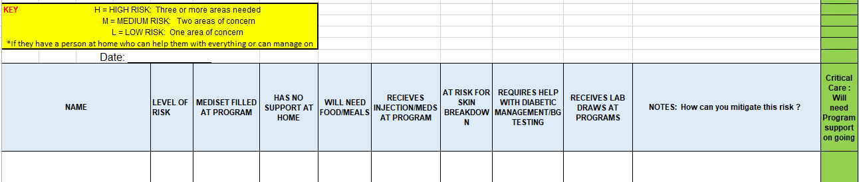
Participant Risk Assessment
During the first week of program on hold a risk assessment was performed on all the ADS participants via a telephone call – guidelines and form from the Adult Day Health Care Council.
Notes:
The form has the name of the participant – includes mediset filled at program, check if participant has family support at home, will he/she need food, does the participant need injections at program, is the participant at risk for skin breakdown, does the participant need diabetic management and testing; does the participant need lab draws – how can the organization mitigate the risk. Last column in “Green” – participant will need program support ongoing.
Evaluation key in yellow – suggests High risk – if three or more areas are checked off; Moderate risk is two areas are checked and low risk if one area is checked.

Slide 11
Results of the Risk Assessment
We identified that there were 25-30 participant who fell in the high risk category
Participants very confused overall with the sudden placement of program on hold
They needed a lot of questions answered related to Covid-19
These participants had little or no support at home
They were concerned of meeting their daily needs of nutrition/care support
They did not know how they would spend their time at home

Slide 12
St Ann’s Development of an ADS Wellness Program
Organization’s Primary Goal
To ensure wellness and safety of the participants, minimizing their use of Emergency Department while the program is on hold
Notes:
Very supportive Senior Leadership Team led to a brainstorming session of how can we support our participants with this sudden hold in program. A team of 3-4 of us met a couple of times and we had a plan put together in 48 hours.

Slide 13
Funding to Initiate the Program
This program was put in place with the seed money from an existing grant to Adult Day Services from the
Greater Rochester Health Foundation

Slide 14
Services Provided
Telephone calls to participants weekly and/or biweekly basis
  Wellness Coordinator
  RN nurse – medical participants
Delivery of meals
Supplements
Activity Kits
Pharmacy Refills
Digital blood pressure cuffs, thermometers and pulse oximeters provide to high risk participants.
Incontinent garments
Notes:
All participants receive a call from the Wellness Coordinator. Coordinator is also helping set-up medical appointments. Coordinate transportation for medical need/s e.g.. Picking up medical shoes; Weekly check in to see how participants are doing and what their needs are – Provide social stimulations by communicating to the participants and provide reassurance
RN keep in touch with health care providers , RN will set up medi-sets ; sending medication list/s; RN works with external vendors to address MDE ( Medical durable equipment )
Medical participants receive a call from the nurse to follow up on their medical needs.
Meals – arrangements made with Meals on wheels & Nutrition Services at St. Ann’s to provide one hot meal pack with juice/milk and cookie for 5 days
Supplements – provided to those who were receiving it to boost intake at program
Weekly Activity packets – put together by the Life Enrichment Therapist. Crayons, pencils provided. Activities include pictures to color, puzzles, word search
Pharmacy refills - for those who use the pharmacy then the drivers will deliver the medications to participants
Digital Devices - RN provides instructions/education on how to use equipment
incontinent garments for people who are in need of such items, redness with recommendation/s

Slide 15
Logistics
As all charts for participants on EMR were on hold. We created call logs for all participants in excel
Logs have specific information to be filled in by the Wellness Coordinator or nurse
Life Enrichment Therapist prepares weekly activity packet to engage participants at home. At the first delivery crayons/pencils and pens were provided to the participants

Slide 16
Continued…
Each call by the coordinator and nurse are logged with check marks and comments to the guided questions
Coordinator tasks:
  Call all participants once a week. High risk vulnerable participants are called twice a week or as per their needs

Slide 17
Continued…
  Maintain call logs
  Prepare lists for drivers to deliver meals
  Prepare packages ready which includes meals, continence care, supplements, medical devices and medication deliveries

Slide 18
Continued…
  Assist with setting-up transportation for participants
  Making appointments for participants as needed for doctor’s office; Wound Center, Podiatry, Physical Therapy
  Billing:
    Calls for authorization from insurance
    Consent from participant
  Processing participant request for prescription refills at the in-house pharmacy
Notes:
Setting up transportation requires calling the insurance company for medi-cab service

Slide 19
Sample Participant Care Plan
Care Plan
Interventions: Provide wellness checks for our participants during this time when ADHC programs are on hold related to Covid-19 virus pandemic; provide social and emotional support, assess for lack of support, identify home bound needs such as food insecurities, ADL challenges, concerns for HTN management, diabetes management, medication management or other chronic condition management. Identify lack of transportation to obtain necessities or attend medically necessary appointments, identify any safety concerns, provide Covid wellness checks (per ADHC questionnaire). Measures taken will help maintain health and minimize emergency usage
Outcome: Participant will remain well and safe at home with adequate support
Plan:
Provide Weekly Wellness calls
Assist with access to services Registrant may need, but does not have at home
F/U with diabetes and asthma management
Provide 5 meals per week
Provide activity packets weekly

Slide 20
Telehealth Calls –
Guideline Questions For Wellness Coordinator
How is your overall health?
Do you have home care services visiting to help you with care?
Have you been checking your body temperature?
Do you have any symptoms of cold, dry cough, nausea, vomiting and diarrhea?
Have you lost sense of taste or smell?
If receiving meals – how have your meals been. Are you satisfied?
How is your appetite and intake?
Are you drinking adequately?
Are you taking the medications as prescribed by your physician?
Are you enjoying the activity kit?
Do you feel you have adequate information related to the pandemic – Covid-19. What’s happening around you?
Are there any changes in your health condition that you would like us to follow-up or help you set up and appointment with your physician?
How are you taking care of yourself at home.
Who is visiting you?
Checking on incontinence wear needs

Slide 21
Telehealth Calls –
Guideline Questions For Nurse
RN calls are made to participants who have on-going medical needs
These participants were identified at the initial risk assessment and ongoing additions are made based on needs as identified by the Wellness Coordinator
Nurse primarily provides direction on using digital devices – thermometer, wrist blood pressure machine, glucometer.
Direction to participants with diabetes, hypertension and wounds on medication management, dressing change reminders.
Assessment for psycho-social support is made during the call

Slide 22
Benefits of Telehealth
Coordinator is bilingual so she is able to meet the needs of Spanish speaking participant.
Developed a connection with the participant. Some participants wait to receive her call
Good way to check on the physical and emotional health of the participant
Provide timely update information related to Covid-19 as many are feeling lost
Last but most important – Ability to provide reminder to stay safe and healthy

Slide 23
Challenges of Telehealth
Technology limitations – some have the phone but do not know how to use it or are unable to while some do not have a device at home to communicate.
Participants are ignorant of the situation – do not want to be bothered with a phone call
Ability to hear but not visually see. There could be a gap between what we hear and reality
Limited time – Making calls to 104 participants requires time. Some participants take more than expected time
Notes:
Share a side challenge – that with insurances having different models for reimbursement. In-spite of providing highest quality services we are unsure of how much will be reimbursed.

Slide 24
Participant Feedback
Majority of the participants receiving services are very grateful of the services supported by the Adult Day Services – Wellness Program
Many want the continued services but do not want to be bothered by a call. So there is a lot of convincing by the coordinator to receive her calls – reiterating the importance to stay connected

Slide 25
Future of Telehealth
Next generation online Case Manager…hold promise
Given the population that our Adult Day Services serves, for the underserved population warrants a lot of education and they will need the following:
  Technology in hand – phone/internet
  Guaranteed access
  Ability to troubleshoot or receive assistance
  Education on how to use technology
  why they need to stay connected with provider

Slide 26
Telehealth should be an option based on a case by case evaluation.
Adult Day Services provides socialization for the elders which is vital for some to maintain health.
Thank you for giving me the opportunity to present today!

Slide 28
Telehealth at adhc
Striving to serve our registrants at home to maintain their medical and emotional needs while remaining safe in the community.

Slide 29
What is Telephonic Service?
  Telephonic Service is conversation via telephone that allows providers the ability to conduct an assessment, monitoring, evaluations and management services where face to face visits are not recommended and are appropriate to deliver.

Slide 30

What does this mean for adhc?
Adhc services without walls
Offering and delivering ADHC services to our registrants with in their home environment.
Changing our mind set on how we will deliver those services.
Building relationships and utilizing community resources to collaborate services.

Slide 31
Get Ready to Start Telephonic Services – ADHC Without Walls!
Comprehensive Adult Day Services – Medical Model
    Telephonic Policy and Procedure for ADHC without walls
    Telephonic Policy and Procedure for Qualifying Members
    Telephonic Policy and Procedure for Care Planning
    Telephonic Care Plan Library
    Telephonic Progress Note Template or log
    Verbal Consent Form – Dual Signature and Date from IDT Team
    Create a Schedule board
    Create a Minute and billing Tracker Report
    Establish and create a Referral Resource list- Community, Physicians, Professional Health Care Agencies
    Create a MLTC Letter and Authorization Request Form
    Create a Welcome to ADHC with out walls letter –
      Indicates what services will be offered
      Indicate what will be included in the Comprehensive Person Centered Care plan
      Indicating that they can disenroll at any time
      Contact information on hours of operations and after hours hotline (if applicable)

Slide 32
What is Provided With Telephonic Services?
* Assessments, Evaluations and Monitoring
* Social services
* Case management
* Behavioral health services
* Nutritional services
* Health education
* Medication management
* Therapeutic activities
* Reliable referral sources
* Emotional support during quarantine

Slide 33
Actions Related to the Services but not limited to
  Monitoring of COVID- 19
  Assessments, Evaluations and Monitoring of current and new onset diagnosis
  Schedule and or refer Physician or Health professional appointments
  Coordinate Ancillary Services such as Labs, Pharmacy and Xray.
  Advocate for needed adaptive equipment and medical supplies
  Coordinate and support insecurities of food supply
  Behavioral Health screening and counseling
  Provide Emotional support and coping strategies during quarantine
  Provide Emotional support and behavioral plans to those with Psychiatric Illnesses
  Registrant and family education
  Mailing of materials or activities
  Arrange for Medical Transportation
  Assist with Medicaid and entitlement issues
  Provide referrals in the community for Physicians or Health Care professionals such as PT, OT and speech.
  Coordinate and facilitate referrals for in home services such as Nurses or Certified Nursing Assistants

Slide 34
Identifying Registrants that Will Benefit From Telephonic Services to Remain Safe in the Community During ADHC Closure
  Home support levels (who do they live with, what kind of support do they have with friends and family)
  General health – primary and secondary diagnosis
  ADL and IADL status
  Dietary needs
  Medications administration/support obtaining supply
  Fall risk – adaptive equipment
  Cognitive status
  Emotional status
  Lack of community resources
  Confirm meal previsions are adequate
  Negate any registrant concerns with interruption of services
  Consenting to participate in Telephonic Services – ADHC shall protect and promote the registrants rights and encourage and assist the registrant to exercise these rights.

Slide 35
Communication Barriers
You may Face
Alteration in Communication R/ T (deficits/ impairments/ diagnosis/ mini mental)
  Communication with care provider to help facilitate registrants needs.
Alteration in Communication R/ T (deficits/ impairments)
  Use other forms of communication such as video or text to meet the registrants needs.

Slide 36
Telephonic Services During the COVID-19 Outbreak
Verbal Consent
-----------ADHC FACILITY NAME ------------------------will be offering Telephonic Services to member’s that need continuous support while being home on New York’s State Emergency Order from the COVID-19.
Our services will be offered thru non face to face communication thru Telephonic Services. The program will offer services to registrants who are in need of Nursing Assessments, Nursing Monitoring, Case Management, Health Education and Social/Emotional Support during the closure of our program.
On this date: ______________________________ Registrant: __________________________________ gave verbal consent via. Telephone that they accept the telephonic services we can offer, and new plan of care created for this period. Registrant aware that this plan of care is temporary and will discontinue once Full ADHC services resumes operations.
ADHC STAFF WITNESS:
NAME: ________________________________SIGNATURE: ____________________________ TITLE:_________________________________
NAME: ________________________________SIGNATURE: ____________________________ TITLE:_________________________________

Slide 37
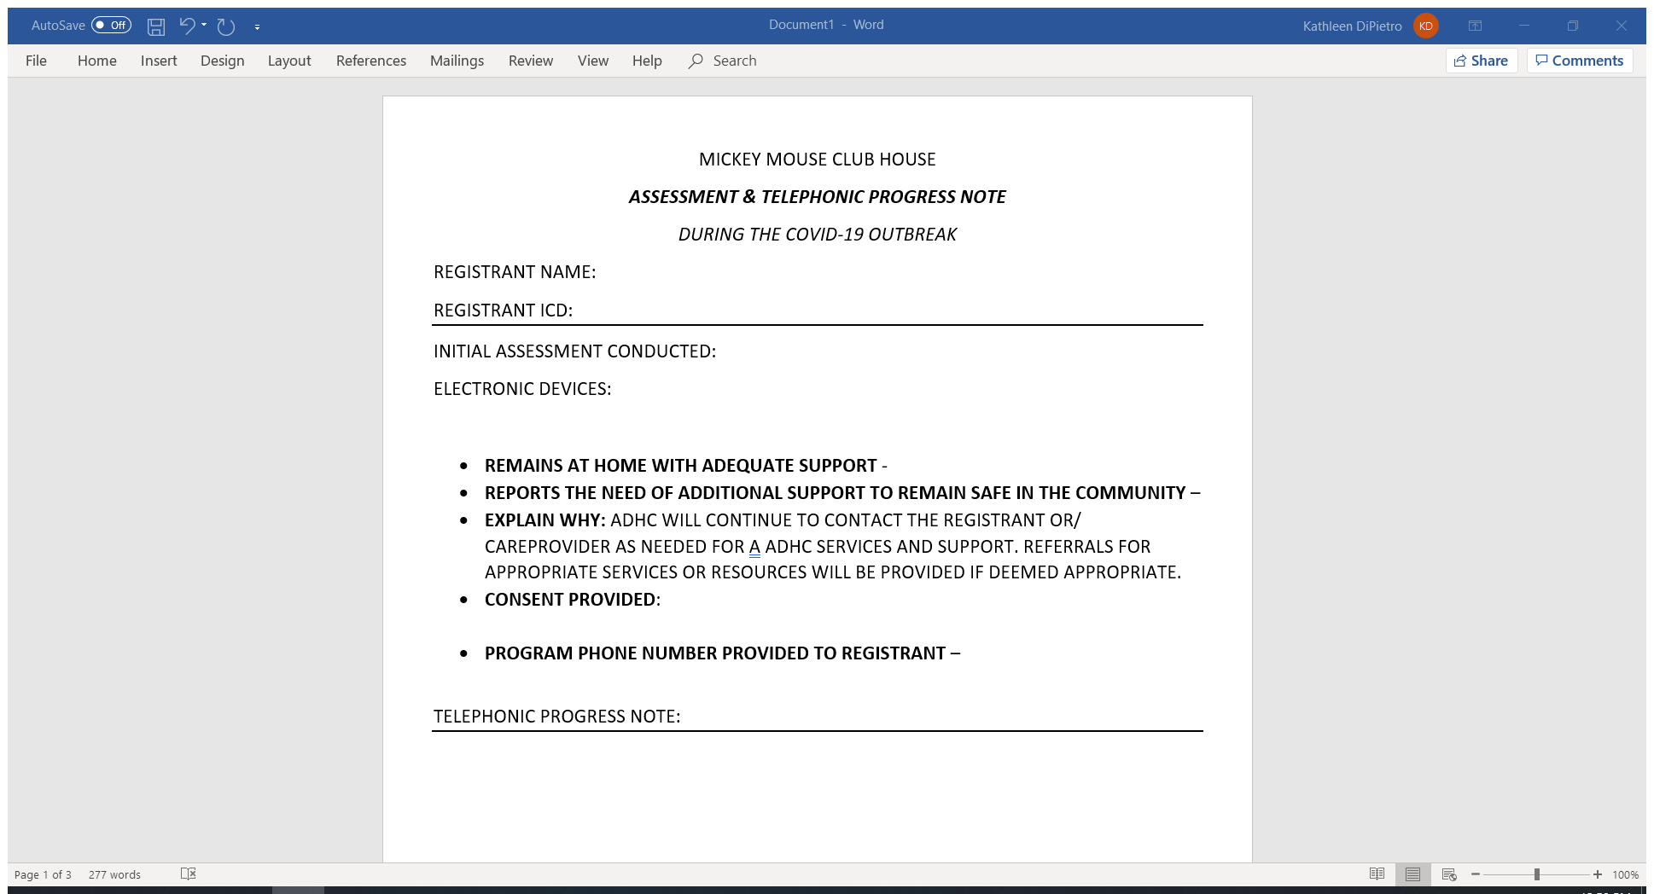

Slide 38
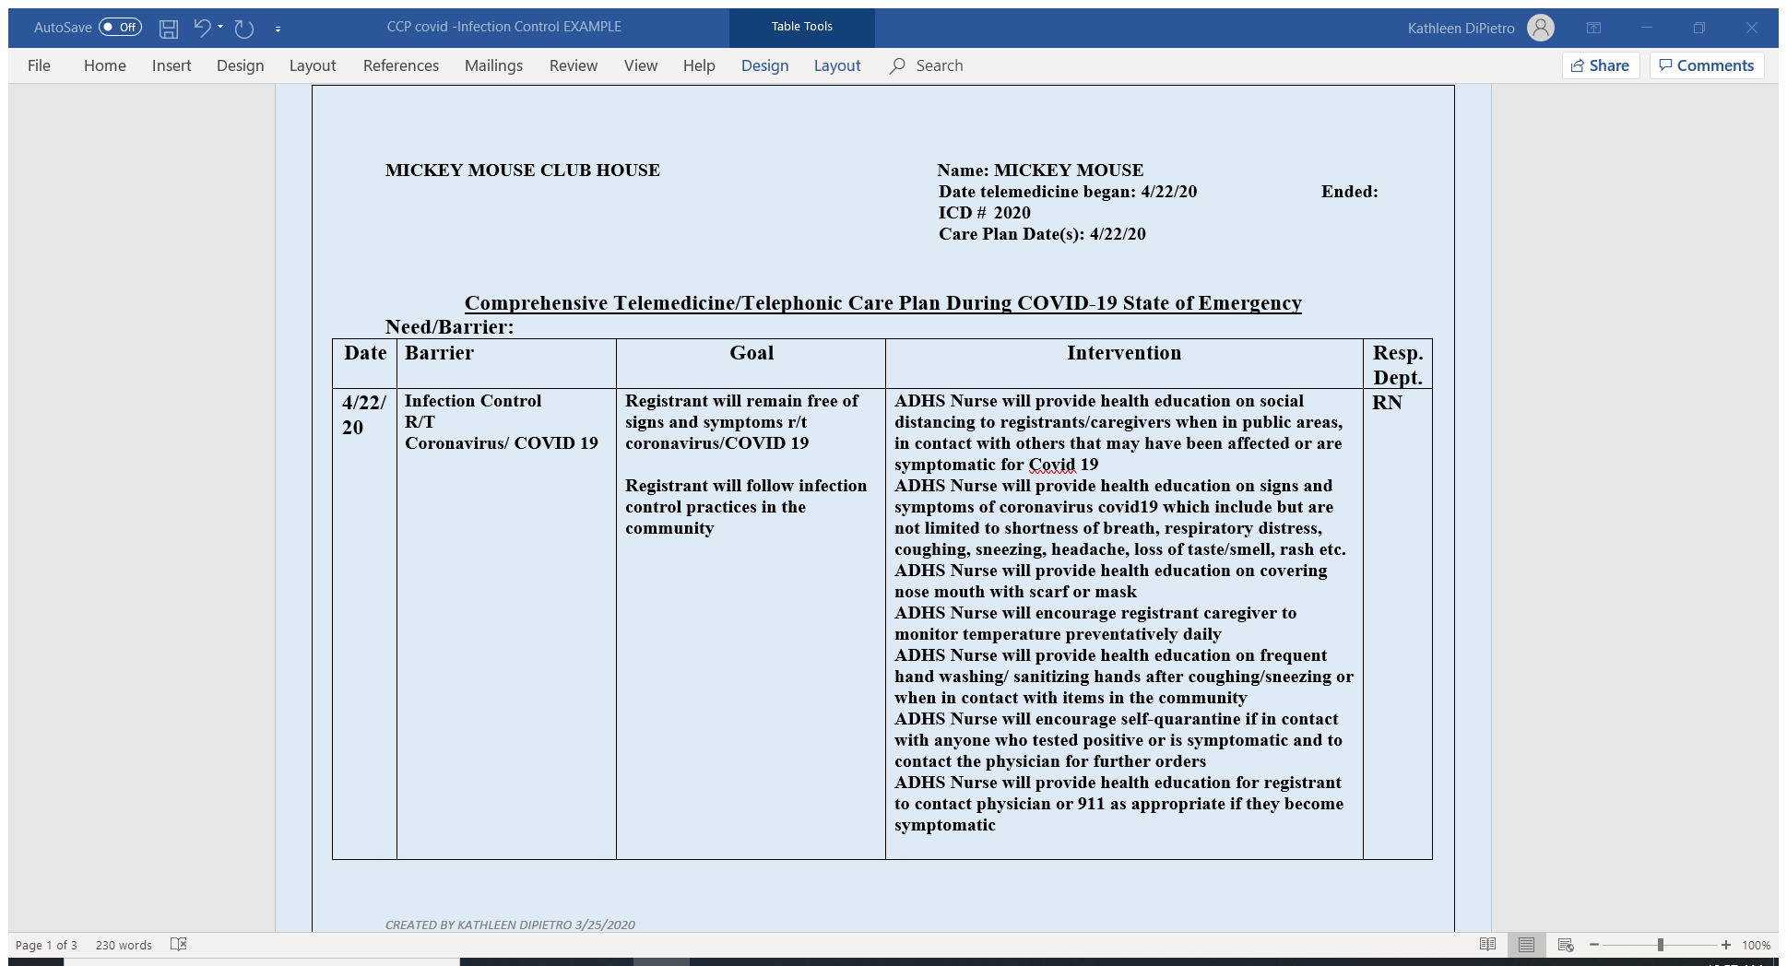

Slide 39
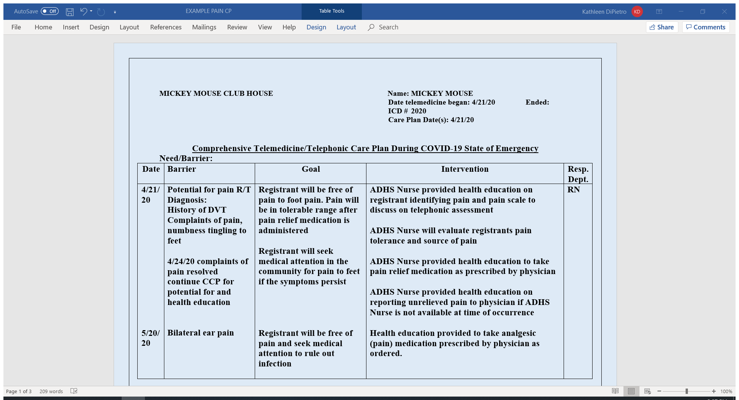

Slide 40
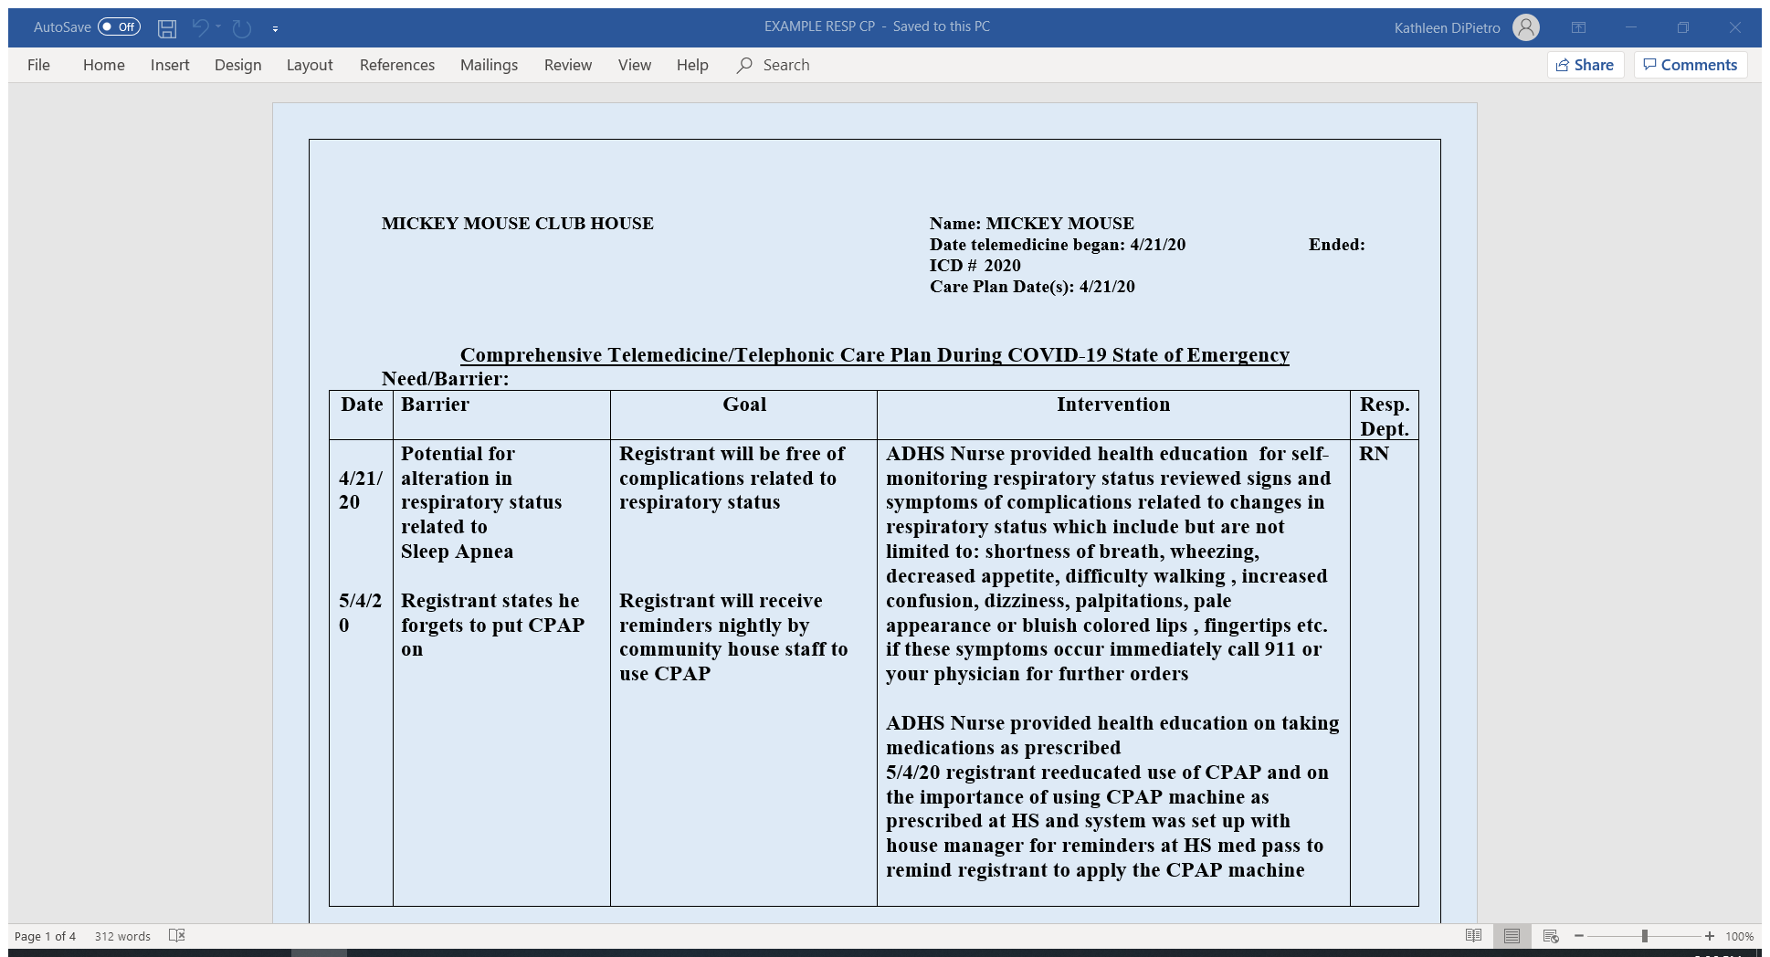

Slide 41
The Barriers we Face With Telephonic Services
  Limited ADHC Telehealth guidance from the state
  Supportive Housing limitations on level of assistances
  Registrants not having access to electronic devices to be able to visually see barriers such as:
    Skin integrity
    Cuts and bruises
    Equipment
    Return demonstration
    Timely telephonic visits
    Home obstacles or barriers
    Communication barrier

Slide 42
ADHC Telehealth Quality Tracking
  Tracking quality measures are important for ensuring registrants receive the same standard of care as if they were provided services face to face.
  Create benchmark achievements
  Make necessary improvements to areas that will increase outcomes
 | COVID-19 POSITIVE CASES | PERCENTAGE
COVID -19 | 0 | 0.00%
 | HOSPITALIZATION
FALLS | 2 | 8.33%
DIABETES | 0 | 0.00%
UTI | 1 | 4.17%
COPD | 0 | 0.00%
PNEUMONIA | 0 | 0.00%
COVID -19 | 0 | 0.00%
PSYCHIATRIC DIAGNOSIS | 0 | 0.00%
SUBSTANCE ABUSE | 0 | 0.00%
 | LONG TERM CARE PLACEMENT
REHAB | 2 | 8.33%
ADL/ IADL CARE | 0 | 0.00%
 | FOOD INSECURITIES
FOOD DEMAND | 0 | 0.00%

Slide 43
ADHC Without Walls: National Perspectives
Brendan Flinn
Director of Medicaid and HCBS Policy
LeadingAge (national office)

Slide 44
Intro to LeadingAge National Office
More than 5,000 not for profit aging services members, business partners and about 40 state partner organizations (like LeadingAge New York).
Close to half of our provider members offer some sort of home and community-based services, including adult day services.
Our staff (~90) work in conjunction with state partners to support/serve our members through advocacy and policy work, online education and conferences.

Slide 45
Trends Before COVID-19 That Remain
Home and community-based services are on the rise.
  CDC survey estimates that adult day services recipients in NY increased by 5% from 2014 to 2016.
Nursing home occupancy is decreasing.
  A LeadingAge report found that even with more than 550 nursing homes closing from 2015 to 2019, occupancy still decreased by 2 percentage points.
People prefer to stay in their homes and communities when possible.
Our 65+ population is set to skyrocket, with huge increases particularly in the 75+ category.

Slide 46
Telehealth before COVID-19
Telehealth isn’t new, but it has never received as much attention as it is getting now.
Before the pandemic, there was no strong federal prioritization to expanding telehealth.
Considered more ancillary to actual face to face services, not a service in its own right.
Federal policy constrained how telehealth could be used in Medicare, limiting its growth across the market.

Slide 47
Legislation Affecting Adult Day and Telehealth
Families First Act (Medicaid FMAP increase, nutrition programs, some telehealth)
CARES Act (Paycheck Protection, Provider Relief, additional telehealth action)
Proposed bills and LeadingAge asks

Slide 48
COVID-19 Changed the Telehealth Policy Landscape
Following COVID-19, Medicare-funded services have seen a spike in what they can do with telehealth.
Includes home health, hospice and skilled nursing (rehab).
For these services, most provider types, including therapies, can conduct virtual/telehealth visits and receive payment.
Some limits still exist. CMS requires that certain telehealth services must be delivered through audio/video means, limiting who can access it. Routine visits can be held by audio.

Slide 49
That’s Medicare. What about ADHC?
CMS and Congress are becoming more telehealth-friendly, which could make its way to Medicaid and LTSS.
The CMS administrator and other key leaders indicating that many of the “emergency” changes expanding telehealth may be here to stay.
Widespread use among the public may also further the long-term use of telehealth.
VA has also expanded coverage for ADHC to include telehealth delivery, but has had mixed reviews.

Slide 50
State Adult Day Actions Rely on Telehealth
With CMS approval, many states (including New York) have allowed adult day services providers to offer services via telehealth.
Each state’s plan has varied, with some states imposing more stringent requirements on method (e.g., requiring audio/video, requiring some in-home care) and on what can be billed.
Some states have also created retainer payment policies that include some basic telehealth requirements. Limitations: don’t cover full rate, time limited.
Because each state controls its own adult day policymaking, we are seeing a patchwork of approaches.

Slide 51
Telehealth as Reopening Supplement
As states reopen and include adult day services in those plans, telehealth may become a key supplement during the transition back to care.
Social distancing guidance will likely remain in place, which for ADHC means fewer people can be inside the physical plant at a given time.
If providers are forced to limit how many registrants can be in a center on a given day, telehealth may help with continuing services for those on “off” days or time periods.

Slide 52
Role of Adult Day in a Post-COVID 19 World
Nursing homes and residential settings have been at the forefront of the COVID-19 pandemic.
While facilities have stepped up to care for their residents (and staff), it is likely that public perception of these settings will take a hit.
People may be less likely to pursue a nursing home admission, or even less intensive settings (e.g., assisted living, independent living).
If more older adults are at home, more older adults will likely need home and community-based care. And that’s where ADHC fits in.

Slide 53
Wrap Up…
Has Changed
Telehealth expansion will likely have lasting influence on all types of services.
How the public perceives aging services.
What adult day centers can do within the four walls (e.g., social distancing).
Has Not Changed
Our older adult population is growing and itself aging.
More people will need services and supports.
Public preferences toward community living.

Slide 54
National Office Resources
COVID-19 Resource Website: www.leadingage.org/COVID19
Daily 3:30 PM EST COVID-19 Update Calls
Annual Meeting- Virtual! http://leadingageannualmeeting.org/
LeadingAge Learning Hub: https://learninghub.leadingage.org/
Member Community: https://www.leadingage.org/member-community
Contact: Brendan Flinn
bflinn@leadingage.org
585-820-8575

Slide 55
ADHC Without Walls: Benefits, Barriers, and the Business of Telehealth
Thank you for participating in this webinar training.
Brought to you by a grant from the Mother Cabrini Health Foundation
Candice Duffy, director, Schofield ADHC
Kathleen DiPietro, director, Middle Island West and Middle Island East ADHC
Brendan Flinn, director, HCBS policy, LeadingAge
Rola O’Meally, director, St. Ann’s Community ADHC programs

