Slide 1
New York State Process to Inform the
2015 White House Conference on Aging (WHCoA)

Slide 2
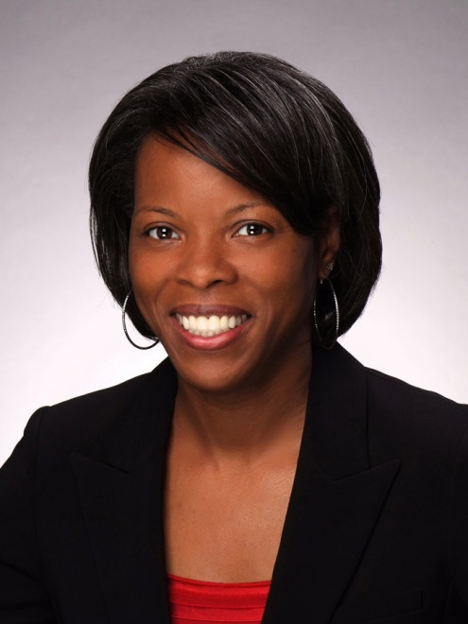
Opening Remarks
Corinda Crossdale
Director
New York State Office for the Aging

Slide 3
Partners
Laura Cameron
Executive Director
Association on Aging in NY

Slide 4
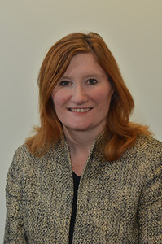
Partners
Erin Mitchell
Manager of Community Outreach
AARP New York

Slide 5
Partners
Greg Olsen
Executive Deputy Director
New York State Office for the Aging

Slide 6
Goals of Webinar
Understand the purpose of the WHCoA
Describe the 4 WHCoA themes
Describe NYS process to collect information and recommendations to inform the WHCoA
Review how recommendations will be shared with WHCoA

Slide 7
Purpose of the 2015 WHCoA
The White House has held a Conference on Aging each decade since the 1960s to identify and advance actions to improve the quality of life of older Americans. The 2015 White House Conference on Aging is an opportunity to look ahead to the issues that will help shape the landscape for older Americans for the next decade
2015 marks the 50th anniversary of Medicare, Medicaid, and the Older Americans Act, as well as the 80th anniversary of Social Security.

Slide 8
Purpose of the 2015 WHCoA
The 2015 White House Conference on Aging is an opportunity to recognize the importance of these key programs as well as to look ahead to the issues that will help shape the landscape for older Americans for the next decade.

Slide 9
2015 WHCoA
The White House is committed to hosting a White House Conference on Aging in 2015 and is seeking broad public engagement and is working closely with stakeholders in developing the conference.
They plan to use web tools and social media to encourage as many older Americans as possible to participate.
They are engaging with stakeholders and members of the public about the issues and ideas most important to older individuals, their caregivers, and families.
They are encouraging people to submit their ideas directly at http://www.whitehouseconferenceonaging.gov/

Slide 10
How WHCoA Issues Were Selected
WHCoA listening sessions began in July 2014 and will continue until the Conference in July 2015
2015 Official WHCoA Listening Sessions
Tampa, FL: February 19
Phoenix, AZ: March 31
Seattle, WA: April 2
Cleveland, OH: April 27
Boston, MA: May 28
Stakeholder and members of the public, including older individuals, their caregivers, families, key aging leaders and advocates identified four common themes.

Slide 11
Four WHCoA Themes

Slide 12
WHCoA Themes
Retirement security is a vitally important issue. Financial security in retirement provides essential peace of mind for older Americans, but requires attention during our working lives to ensure that we are well prepared for retirement.

Slide 13
WHCoA Themes
2. Healthy aging will be all the more important as baby boomers age. As medical advances progress, the opportunities for older Americans to maintain their health and vitality should progress as well and community supports, including housing, are important tools to promote this vitality.

Slide 14
WHCoA Themes
3. Long-term services and supports remain a priority. Older Americans overwhelmingly prefer to remain independent in the community as they age. They need supports to do so, including a caregiving network and well-supported workforce.

Slide 15
WHCoA Themes
4. Elder justice is important given that seniors, particularly the oldest older Americans, can be vulnerable to financial exploitation, abuse, and neglect. The Elder Justice Act was enacted as part of the Affordable Care Act, and we need to realize its vision of protecting older adults from scam artists and others seeking to take advantage of them.

Slide 16
How to Provide Input to WHCoA
National Input
Provide input directly to the WHCoA on the national website - http://www.whitehouseconferenceonaging.gov/
NYS Process
Provide input via a survey tool posted on the website of the Association on Aging in New York - http://www.agingny.org/WhiteHouseConferenceonAging.aspx
Participate in one of 5 regional recommendation forums in March

Slide 17
WHCoA Website

Slide 18
NYS Process to Inform WHCoA
NYS Process
Provide input via a survey tool posted on the website of the Association on Aging in New York - http://www.agingny.org/WhiteHouseConferenceonAging.aspx
Participate in one of 5 regional recommendation forums in March

Slide 19
NYS Process Timeline - Website
Wednesday March 5 – Survey goes live
Wednesday, April 15 – Survey closes
Ongoing
Website will continue to operate and will post updates on the NYS process and report of recommendations when available

Slide 20
NYS Process Website & Survey
Front page contains the 4 WHCoA Themes
Under each WHCoA theme there are three links

Slide 21
Example – Retirement Security
Background on the General Theme
Retirement Security: Financial security in retirement provides essential peace of mind for older Americans, but requires attention during our working lives to ensure that we are well prepared for retirement. Read more about Retirement Security.
Guidance Questions
Click here for questions to consider before taking the Retirement Security survey. (These questions are only a guide to help you answer the survey questions that appear in the actual survey. The questions are for guidance purposes only and don’t necessarily have to be answered, but instead, should help you think about the variety of issues/ways to provide recommendations under this #WHCOA Retirement Security theme.)
Provide Your Recommendation
Click here to provide recommendation(s) to improve Retirement Security.

Slide 22
First Link – Background Information

Slide 23
Second Link - Guidance Questions

Slide 24
Third Link – Recommendations Survey
Only 4 Questions

Slide 25
Things to Remember
Each of the 4 general themes has its own survey. Provide your recommendation(s) under the appropriate theme(s).
Provide as many or as few recommendations as you want.
Guidance questions are to provoke thoughtful responses, they do not have to be answered.
Survey closes on Wednesday April 15th.

Slide 26
5 Regional Forums
Will be held on Thursday March 26 and Friday March 27

Slide 27
Regional Forum – Erie County
Thursday March 26
2:00 – 4:00 p.m.
Cheektowaga Senior Center
3349 Broadway, Cheektowaga 14227
RSVP to Sharon.Foley@aging.ny.gov

Slide 28
Regional Forum – Onondaga County
Friday March 27
10:00am - Noon
Van Duyn Center
Bea Latremore Room, 5075 West Seneca Tpk
Syracuse, 13215
RSVP to Sharon.Foley@aging.ny.gov

Slide 29
Regional Forum – Albany County
Thursday March 26
1:00 – 3:00 p.m.
Beltrone Living Center
6 Winners Circle, Albany, 12205
RSVP to Sharon.Foley@aging.ny.gov

Slide 30
Regional Forum - NYC
Thursday March 26
Time TBD
Location TBD
RSVP to Sharon.Foley@aging.ny.gov

Slide 31
Regional Forum – Long Island
Friday March 27
2:00 – 4:00 p.m.
Atrium at Malloy College
RSVP to Sharon.Foley@aging.ny.gov

Slide 32
Sharing Recommendations with WHCoA
Wednesday April 15th – Wednesday May 13th
Information and recommendations collected and analyzed
May 28th – Recommendations Delivered in Boston
June – Final Written Report of Recommendations Completed
July – Written Report of Recommendations Submitted to
WHCoA

Slide 33
Wide Participation is Welcome!
Encourage your members/coalitions/networks to participate in any of these options.
Your expertise is needed to inform the WHCoA on policy, program, regulatory, fiscal changes needed to improve the lives of older Americans
Be creative, new ideas are important.

Slide 34
Questions????
Please submit any questions to:
Kelly.Mateja@aging.ny.gov
Questions will be answered and posted on
http://www.agingny.org/WhiteHouseConferenceonAging.aspx

