Slide 1
LeadingAge NY
Fall 2013 Reimbursement Update
Darius Kirstein and Patrick Cucinelli

Slide 2
Fall 2013 Reimbursement Update
Agenda– A review of issues to consider for provider budget-making stemming from:
Federal funding provisions
State budget
Medicaid redesign
Medicare and Medicaid payment changes
  a “laundry list” approach

Slide 3
Fall 2013 Reimbursement Update
Sequestration
The automatic spending cuts went into effect on March 1, which means the following for the field of aging services:
Medicare reimbursement to health care providers cut by 2%. These cuts will amount to an $11 billion cut in Medicare spending (claims with dates of service starting 4/1/13).
A 5.1% cut in Section 202 housing funding, amounting to $18 million.
The Administration on Aging, which manages Older Americans Act programs, cut by 5.1%, amounting to $86.7 million.

Slide 4
Fall 2013 Reimbursement Update
President Obama’s 2014 budget proposal would achieve $1.8 trillion in deficit reduction over the next decade.
The spending and revenue issues raised by the president's budget proposal likely will come to the forefront when the national debt ceiling must be raised this summer.
(As you may recall the last debt ceiling debate led to sequestration.)

Slide 5
Fall 2013 Reimbursement Update
The U.S. House of Representatives passed its Path to Prosperity: A Responsible, Balanced Budget.
The U.S. Senate passed the Foundation for Growth: Restoring the Promise of American Opportunity plan.
(Apparently, the budget plan with the most effusive, euphemistic title wins.)

Slide 6
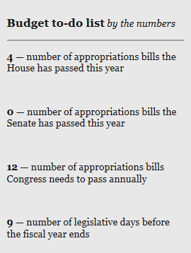
Fall 2013 Reimbursement Update
Federal 2014 Budget (as of Sep 6)
October 1 is FFY start
House & Senate spending targets diverge by $91B
Continuing resolutions likely
Debt ceiling debate (need to act in October)
Possible proposals to cut to Medicaid / Medicare possible
Sequestration likely to continue

Slide 7
Fall 2013 Reimbursement Update
Implications for NY
NY has a number of issues pending with CMS that may be slowed or influenced by federal budget delays and/or funding disruptions
Most notably, a waiver that would provide $10B of Federal savings from Medicaid redesign to the state

Slide 8
Fall 2013 Reimbursement Update
M
Medicaid Global Spending
The 2013-14 enacted State Budget extends through March 31, 2015 authorization for both the Medicaid global spending cap and the “super-powers” granted to the Commissioner of Health to reduce spending if expenditures exceed projections. The global cap limits growth in Department of Health (DOH) State Funds Medicaid spending to the 10-year rolling average of the medical component of the Consumer Price Index (CPI), currently estimated at 3.9%.

Slide 9
Fall 2013 Reimbursement Update
M
More on Global Cap
The Medicaid program finished SFY 2012-13 $2 million under target. Included within the amount was $200 million in expenses that would have otherwise occurred in SFY 2013-14, bringing adjusted under spending to $200 million for the year. This under spending for the year can be explained by:
Lower utilization of services ($130 million). The cost to serve each Medicaid recipient has actually declined from a high of $8,493 in 2009 to $7,864 in 2012.
Higher local administration savings ($40 million). A significant MRT initiative impacting State and local governments involves the takeover of the administration of the program by the State by March 2016.
Lower State operations costs ($30 million). The budget included funds to support the implementation of MRT initiatives. This savings is due to lower-than-projected implementation costs.
Source: DOH Annual Global Cap Report

Slide 10
Fall 2013 Reimbursement Update
M
More on Global Cap
$15.91 billion in the current fiscal year
$16.5 billion in SFY 2013-14 (increase of $510 million).
$17.1 billion for SFY 2014-15
$90.8 million shift in DOH Medicaid administrative costs under the global cap.

Slide 11
NY Total Medicaid Spending Statewide for All Categories of Service Under the Global Spending Cap (2003-2012)
Projected Spending Absent MRT Initiatives *
Aggregate
Spending
for all Programs
(in Billions)
$4.6 billion Estimated Savings
2011 MRT Actions Implemented
Year
 | 2003 | 2004 | 2005 | 2006 | 2007 | 2008 | 2009 | 2010 | 2011 | 2012
# of Recipients | 4,266,535 | 4,593,566 | 4,732,563 | 4,729,166 | 4,621,909 | 4,656,354 | 4,910,511 | 5,211,511 | 5,396,521 | 5,578,143
Cost per Recipient | $7,635 | $7,658 | $7,787 | $7,710 | $8,158 | $8,464 | $8,493 | $8,379 | $8,261 | $7,864
*Projected Spending Absent MRT Initiatives was derived by using the average annual growth rate between 2003 and 2010 of 4.28%.

Slide 12
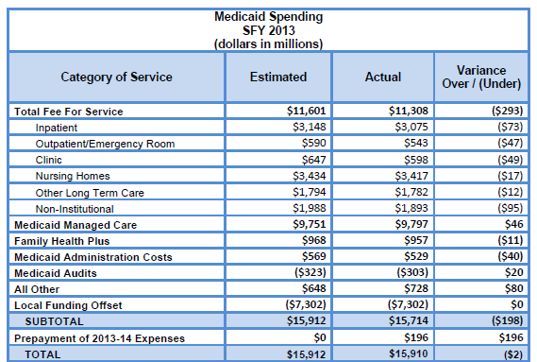
Fall 2013 Reimbursement Update
M
Source: DOH Annual Global Cap Report

Slide 13
Fall 2013 Reimbursement Update
M
Global Cap Results for SFY 2012-13
Since March 2012, enrollment in the Medicaid program has grown by close to 232,500 enrollees (or 4.6%).
During this fiscal year Medicaid managed care programs increased by 345,100 individuals while fee-for-service recipients decreased by 112,600. (Approximately 87,300 of these new enrollees are attributable to the expansion of Medicaid coverage for children under the age of 19 whose family income did not exceed 133 percent of the Federal Poverty Level, which does not incur additional costs under the Medicaid Global Spending Cap.)

Slide 14
Fall 2013 Reimbursement Update
M

Slide 15
Fall 2013 Reimbursement Update
M

Slide 16
Fall 2013 Reimbursement Update
M

Slide 17
Fall 2013 Reimbursement Update
M

Slide 18
Fall 2013 Reimbursement Update
M

Slide 19
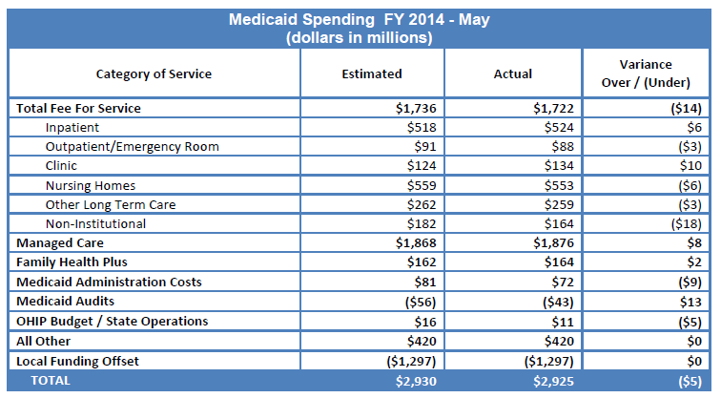
Fall 2013 Reimbursement Update
M
Two months into the 2013-14 SFY Medicaid spending stood 0.2 % below projections
(Monthly Global Cap reports can be accessed here.)
Source: DOH Global Cap Report, May 2013

Slide 20
Fall 2013 Reimbursement Update
M
2% Across-the-Board Cut
SFY 2013-14 State budget extended 2% cut on all Medicaid providers through March 31, 2015
Annual savings associated: $357 million
A number of providers substituted other provisions for 2% cut
For nursing homes, non-reimbursable assessment of .8% adopted in lieu of cut
Budget language added to allow the Commissioner to annul the 2% cuts prior to March 2015 as long as the State remains under the cap.

Slide 21
Fall 2013 Reimbursement Update
M
IGT (Public Nursing Homes)
SFY 2013-14 State Budget allows $32 million of upcoming IGT distribution to be redistributed to those public facilities that were subject to retroactive reductions in payments made beginning in April 2006.

Slide 22
Fall 2013 Reimbursement Update
OMIG
The Office of the Medicaid Inspector General audit target for SFY 2013-14 remains consistent with current year levels at $1.1 billion. The target includes $323 million in cash recoveries and $809 million in savings associated with cost avoidance.
Federal Overpayments
The fiscal cliff legislation extends the period of time during which Medicare contractors can attempt to collect overpayments from providers from three years to five years.

Slide 23
Fall 2013 Reimbursement Update
Managed Long Term Care
The central themes of the governor’s Medicaid managed care (MMC) and managed long term care (MLTC) budget initiatives are: (1) further refinement of the managed care implementation process; and (2) clearing the way for the state to implement its Demonstration Proposal to Integrate Care for Dual Eligible Individuals (often referred to as FIDA - Fully- Integrated Duals Advantage).

Slide 24
Fall 2013 Reimbursement Update
MRT – Managed Care
Covered Populations
  State legislative authority for nearly all Medicaid recipients to be enrolled in managed care
  Across DOH, OMH, OASAS and OPWDD
Covered benefits
  Broad service package including HCBS, ALP and nursing home care
Mandatory enrollment
  Require more recipients to join “mainstream” Medicaid managed care, including Medicaid-only nursing home residents
  Require most HCBS recipients and eventually, nursing home, ALP and waiver recipients to join plans

Slide 25
Fall 2013 Reimbursement Update
MRT – Managed Care
Care coordination
  Encourage formation of health homes, medical homes and ACOs to coordinate care and network services
  Increase expectations of Medicaid managed care plans
Duals initiative (FIDA)
  Enroll certain dual eligibles in integrated Medicare/ Medicaid managed care with service start date of July, 2014 for voluntary participants
  Nursing home population would be included (latest proposal suggests a service start date of Oct. 2014 for voluntary participants)

Slide 26
State Priority 1: Continue MRT Implementation
M
Fund additional supportive housing efforts targeted at high needs Medicaid members.
Continue to drill down into the Medicaid benefit package and propose additional benefit changes to ensure Medicaid members access the most cost-effective treatments.
Implement the Vital Access Provider (VAP) program to assist vulnerable safety net providers transition to more sustainable business models that ensure access to essential services.
Source: Jason A. Helgerson, Medicaid Director, presentation to Citizen’s Budget Commission (May 2013)

Slide 27
State Priority 2: MRT Waiver Amendment
M
We currently have a waiver amendment pending with CMS that would allow us to reinvest $10 billion in MRT generated federal savings back into New York’s health care delivery system.
The amendment is essential to both fully implement the MRT action plan as well as prepare for ACA implementation.
The amendment, which requires federal approval, is a unique opportunity to address the underlying challenges facing NYS health care delivery:
  Lack of primary care;
  Weak health care safety net;
  Health disparities; and
  Transition challenges to managed care.
Source: Jason A. Helgerson, Medicaid Director, presentation to Citizen’s Budget Commission (May 2013)

Slide 28
State Priority 3: FIDA Demonstration
M
A key step in the move to “Care Management for All” is the proposed Fully Integrated Dual Advantage (FIDA) demonstration project.
Through this effort approximately 170,000 dually eligible members (Medicaid and Medicare) will be enrolled into fully-integrated managed care products (in an 8 county area downstate).
The enrollment process will rely on a “conversion in place” approach under which duals enrolled in MLTCP will see their Medicare benefit added to their managed care plan’s portfolio.
Members will be able to opt-out of the Medicare managed care product.
Implementation = April 2014
Source: Jason A. Helgerson, Medicaid Director, presentation to Citizen’s Budget Commission (May 2013)

Slide 29
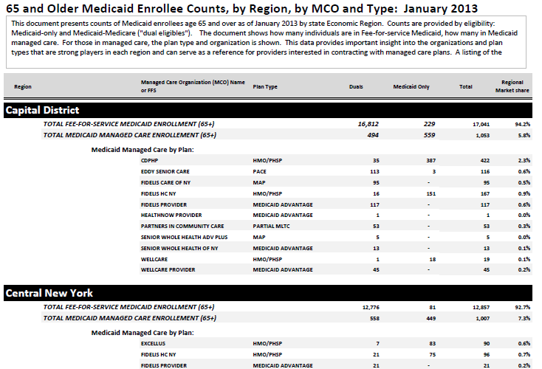
Fall 2013 Reimbursement Update
Managed care resources on our web site include:

Slide 30
Fall 2013 Reimbursement Update
How to identify the managed care plans that serve your area:
Managed Care Plan Directory (by county):
http://www.health.ny.gov/health_care/managed_care/pdf/cnty_dir.pdf
Managed LTC Plan Directory:
http://www.health.ny.gov/health_care/managed_care/mltc/mltcplans.htm
Mainstream Medicaid managed care plans (consumer directories by region): http://www.health.ny.gov/health_care/managed_care/consumer_guides/
Downstate MLTC plans (consumer directories, downstate areas only):
http://www.health.ny.gov/health_care/managed_care/mltc/consumer_guides/index
Regional Medicaid managed care enrollment figures by type and plan:
http://www.leadingageny.org/linkservid/2DE34775-F680-C552-96D1697E81B7A934/showMeta/0/

Slide 31
Fall 2013 Reimbursement Update
Implications for Home and Community Based
Unprecedented activity
Uncertainty around mandatory enrollment timeframes
Referrals to some programs dropping
Provider networks and unit cost dictating referrals
Regulatory oversight not keeping up with marketplace
Closures, consolidations and joint ventures underway

Slide 32
Fall 2013 Reimbursement Update
Implications for Nursing Homes
Volume and referrals
  Managed care may lower use rates
  Provider networks will dictate referrals
  Greater competition among providers on quality and price
  More service differentiation?
Assuming risk
  Major decision on whether to go “at risk” or be “downstream”
  Shared risk/savings models

Slide 33
Fall 2013 Reimbursement Update
M
Source: DOH Weekly Bed Availability Submission Data

Slide 34
Fall 2013 Reimbursement Update
Implications for Nursing Homes
Networks
  How many contracts will plans have?
  Roles and responsibilities in managed care and network arrangements
  Other opportunities (medical homes, ACOs)
  HIT capacity
Reimbursement
  High percentage of revenues
  Level of overall payments from plans
  Capital reimbursement uncertainty

Slide 35
Fall 2013 Reimbursement Update
Implications for ACFs and ALPs
Volume and referrals
  Managed care may find these settings cost-effective
  Provider networks will dictate referrals
  Timing of ALP integration in managed care
Reimbursement
  Lack of clarity on what Medicaid pays for vs. what SSI pays for
  Level of payments from plans
  Level of capital reimbursement

Slide 36
Fall 2013 Reimbursement Update
Implications for ACFs and ALPs
Other areas of uncertainty
  Design of the ALP model
  Service provision in ACFs
  Integration/enrollment in mainstream
  Timing and other elements of MLTC rollout
  Little experience with managed care

Slide 37
Fall 2013 Reimbursement Update
LTC providers face major marketplace dynamics:
  Mandatory Medicaid managed care
  Impacts of reimbursement changes and negotiated rates with managed care plans
  Referring hospitals under pressure to minimize re-hospitalizations and ER use
  Growth of care coordination models across primary, acute, LTC, mental health, behavioral health and disability services
  Threshold decisions about assuming risk

Slide 38
Fall 2013 Reimbursement Update
M
Mandatory Enrollment Timetable
Dually-eligible requiring 120 days or more of community-based LTC (21 and older):
Phase II- Jan 2013: Westchester & Long Island
Phase III- scheduled June 2013 (delayed): Rockland & Orange Counties
Phase IV- December 2013: Erie, Monroe, Onondaga, Albany Counties
Phase V- June 2014: Other counties with capacity
LTHHCP (duals in mandatory counties): in progress
LTHHCP (Medicaid-only statewide): in progress
NH residents in 8-county FIDA region: January 2014 (proposed)
NH residents in rest of state: April 2014 (proposed)
NH residents permanently placed prior to dates above would remain in FFS
ADHC added to Mainstream Medicaid MC Benefit: August 1, 2013
* With possible accelerations if required to meet budget provisions

Slide 39
Fall 2013 Reimbursement Update
M
Current NH Resident Transition into MC
Non-FIDA Counties:
Under the current proposal:
Nursing home residents permanently placed prior to April 1, 2014 and who are in fee-for-service Medicaid would remain under fee-for-service reimbursement for the duration of their stay.
Residents in fee-for-service Medicaid who are determined to require permanent placement on or after April 1, 2014 would be enrolled in a managed care plan.
Those who are enrolled in managed care would remain in their plan for the duration of their stay, even if permanently placed.
Residents new to Medicaid would be enrolled into managed care upon being determined to be Medicaid eligible. The plan will then cover their care for the duration of their stay.

Slide 40
Fall 2013 Reimbursement Update
M
Current NH Resident Transition into MC
8-County FIDA Region (NY City and Suffolk, Nassau and Westchester Counties):
Under the current proposal:
Nursing home residents permanently placed prior to January 1, 2014 and who are in fee-for-service (FFS) Medicaid would remain under fee-for-service reimbursement for the duration of their stay. However, these residents would be passively enrolled in a FIDA plan starting in Jan 2015 with the opportunity to opt out and remain in FFS. They may also voluntarily enroll in FIDA beginning in October 2014.
Residents in fee-for-service Medicaid who are determined to require permanent placement on or after Jan. 1, 2014 would be enrolled in a managed care plan. Those not in FIDA plans in Jan. 2015 would be passively enrolled into FIDA plans beginning in Jan. 2015 with the option to remain in their existing managed care plan.
Those who are enrolled in managed care would remain in their plan for the duration of their stay, even if permanently placed. However those not in FIDA plans would be passively enrolled into FIDA plans beginning in January 2015 with the option to remain in their existing managed care plan.
Residents new to Medicaid would be enrolled into managed care upon being determined to be Medicaid eligible. The plan would then cover their care for the duration of their stay. Those not in FIDA plans would be passively enrolled into FIDA plans beginning in January 2015 with the option to remain in their existing managed care plan.

Slide 41
Fall 2013 Reimbursement Update
M
Current NH Resident Transition into MC
Individual eligible for Medicare and Medicaid (i.e., “duals”) would join an MLTC plan. Individuals eligible for Medicaid only would join a mainstream managed care plan.
These timelines would apply to specialty and non-specialty nursing home residents, although for those under 21 the rules above would become effective April 1, 2015.
DOH-convened workgroup of providers and plans working on transition issues

Slide 42
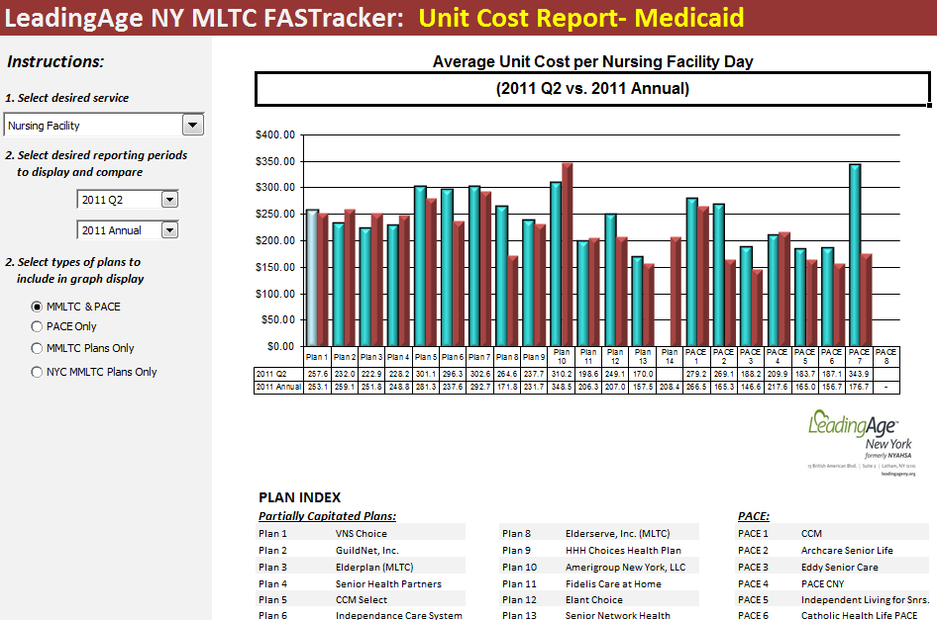
Fall 2013 Reimbursement Update
Managed care resources available:

Slide 43
Fall 2013 Reimbursement Update
Superstorm Sandy
$30 billion from the combined $60 billion federal disaster relief aid package.
$13.9 billion would flow through the state budget
$16.1 billion would be distributed directly to recipients.
Sandy relief spending through the state budget is $1.5 billion for SFY 2012-13 and $5.1 billion in SFY 2013-14. Federal funding is only available through 2017.

Slide 44
Fall 2013 Reimbursement Update
Superstorm Sandy
Impacted providers completed survey of transferred and received patients
DOH compared survey data to eMedNY data
Payments have been processed for homes whose surveys had no discrepancies (check release date Oct 9, total of roughly $7M)
Those with discrepancies will receive notice to review and correct survey discrepancies (on the HCS) as well as to report any Sandy-related care days after Feb 7, 2013
Negative rate and assessment reconciliation adjustments for homes in Sandy-impacted counties that DOH held will be processed

Slide 45
Fall 2013 Reimbursement Update
M
Medicaid Trend Factor
The Executive Budget again proposed to permanently eliminate statutory trend (i.e., inflation) factors for Medicaid providers.
Legislature rejected provision. However:
Trend has been legislatively eliminated each year since 2007
Global Cap governs spending

Slide 46
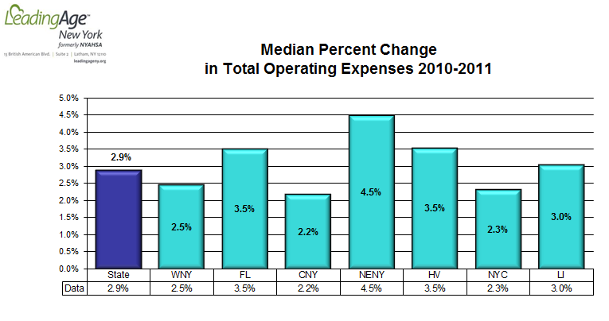
M

Slide 47
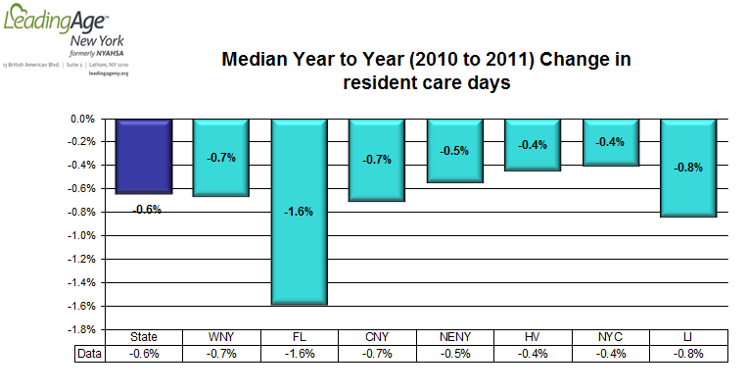
M

Slide 48
Fall 2013 Reimbursement Update
M
Assessment
Medicare maximization requirements and the 6% reimbursable cash receipts assessment tax extended through March 31, 2015.
The 0.8% increase in the assessment tax (over and above the 6%) agreed to in SFY 2011-12 in lieu of the 2% across-the-board Medicaid cut, continues through March 2015 (but may sunset earlier)

Slide 49
Fall 2013 Reimbursement Update
M
VAP
Financially Disadvantaged money into VAP: The 2013-14 State Budget discontinues Financially Disadvantaged funding and transfers the $30 million to VAP (Vital Access Provider)/safety net pool. The $30 million is earmarked for nursing homes and total annual funding for all providers is increased to $182 million for year 2 (of which $51.6 M is committed to Round I projects).
$1B in VAP funding over 5 years included in state’s waiver request
Round I awards: approved 13 projects totaling $69 M over 3 years
156 Round II applications totaling $1.1 B
  24 nursing home proposals totaling $114 M
  6 CHHA proposals totaling $24 M
  87 hospital proposals totaling $639 M

Slide 50
Fall 2013 Reimbursement Update
Adult Day Health Care Services
See nursing home provisions.
Expansion of social models.
Hybrid option.

Slide 51
Fall 2013 Reimbursement Update
Medicare Issues …
Improvement Standard
In the Settlement Agreement, CMS is committed to revising the relevant portions of Chapters 7, 8, and 15 of the Medicare Benefit Policy Manual, within 1 year of the Court’s approval of the Settlement Agreement, to "clarify" the coverage standards to include SNF, HH, and OPT benefits when a patient has no restoration or improvement potential, needs those skilled services.

Slide 52
Fall 2013 Reimbursement Update
Medicare Part B and the “Doc Fix”
The announced spending cut under the SGR for Medicare Part B payments was 26.5 percent for 2013. Congressed approved a conversion factor set at zero, which means that physician Medicare payments will remain relatively unchanged for 2013. The extension of existing Medicare physician payments will cost about $25 billion over 10 years, according to the Congressional Budget Office.

Slide 53
Fall 2013 Reimbursement Update
Therapy Caps
The therapy caps and the exceptions process continues in 2013. The new financial limits are $1,900 for occupational therapy (OT) and $1,900 for physical therapy (PT) and speech language pathology (SLP) combined.
Last year the new law expanded the cap to therapy services furnished in a hospital outpatient department (OPD).
New dollar aggregate threshold amount of $3,700.

Slide 54
Fall 2013 Reimbursement Update
DMEPOS Competitive Bidding
Under the new rules, selected durable medical equipment, prosthetics orthotics and supplies (DMEPOS) will be subject to sole-source coverage by only those suppliers granted awards by CMS. The new Round 2 covers:
Oxygen, oxygen equipment, and supplies
Standard (Power and Manual) wheelchairs, scooters, and related accessories
Enteral nutrients, equipment, and supplies
Continuous Positive Airway Pressure (CPAP) devices and Respiratory Assist Devices (RADs) and related supplies and accessories
Hospital beds and related accessories
Walkers and related accessories
Negative Pressure Wound Therapy pumps and related supplies and accessories
Support surfaces (Group 2 mattresses and overlays)

Slide 55
Fall 2013 Reimbursement Update
Adjustments to Part A Rates
The final net market basket update of 1.3 percent is slightly lower than the 1.4 percent originally proposed due to an increase in the Multifactor Productivity Factor (MPF) from 0.4 to 0.5 percent. This net market basket rate adjustment reflects a full market basket increase of 2.3 percent, less the 0.5 percent MFP required by Section 3401(b) of the Affordable Care Act (ACA), and a 0.5 percent adjustment to correct for an error in forecasting the market basket in FY 2012. CMS estimates that the net market basket update overall will increase SNF payments by approximately $470 million in FY 2014 or an average of about $7 per Medicare patient day.
CMS summarizes the Final Rule programmatic changes as including:
Revision and rebasing of the SNF market basket;
Updates to the labor related share;
A new policy for reporting the SNF market basket forecast error in certain limited circumstances;
A new item to the Minimum Data Set (MDS), Version 3.0 for reporting the number of distinct therapy days; and
Adoption of changes to the diagnosis code used to determine which residents will receive the AIDS add-on payment, effective for services provided on or after the Oct. 1, 2014 implementation date for conversion to ICD-10-CM.
Medicare provider payments were cut by 2 percent beginning April 1, 2013 as part of the spending reductions required by the Budget Control Act of 2011 (i.e., sequestration). Providers should keep in mind that we are now in the first year of the projected nine-year sequestration process. This means that while the schedule of MDS payment rates are not directly impacted, overall Medicare payments to providers will continue to be reduced by 2 percent, unless the White House and Congress can negotiate an alternative.

Slide 56
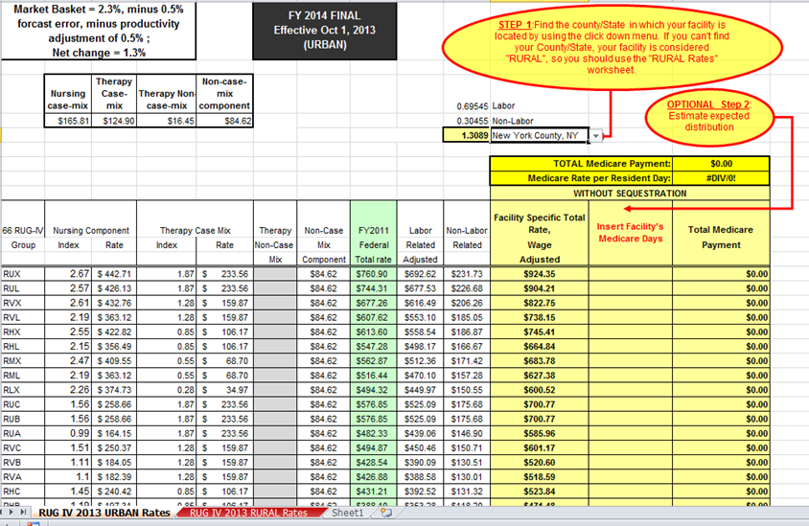
Fall 2013 Reimbursement Update
Medicare Rate Template posted on LeadingAge National web site:

Slide 57
Fall 2013 Reimbursement Update
New Therapy G-Codes
Effective January 1, 2013, CMS is implementing a claims-based data collection system that includes: (1) the reporting of data by therapy providers and practitioners furnishing therapy services, and (2) the collection of data by the contractors.
These G-codes and related modifiers are required on specified claims for outpatient therapy services, not just those that exceed the therapy caps. A testing period will be in effect from January 1, 2013, through June 30, 2013, to allow providers to use the new coding requirements in order to assure that their systems work. During this time period claims without G-codes and modifiers will be processed.
Medlearn Matters # MM8005

Slide 58
Fall 2013 Reimbursement Update
Multiple Procedure Payment Reduction
For those providing multiple therapy services on or after April 1, 2013, and for which payment is made under the physician fee schedule, the 25 percent multiple procedure payment reduction (MPPR) is increased to 50 percent.
Medlearn Matters # 7050.

Slide 59
Fall 2013 Reimbursement Update
Physician Quality Reporting System (PQRS)
CMS continues to use PQRS as a means of promoting quality improvement initiatives and the reporting of quality information by physicians. In the CY 2013 rule, CMS aims to integrate the PQRS reporting requirements with the requirements of the Electronic Prescribing Incentive Program, the Electronic Health Record (EHR) Incentive Program, and the Value-Based Payment Modifier.
MLN Matters # SE0922

Slide 60
Fall 2013 Reimbursement Update
CMS Electronic Prescribing Incentive Program
The Medicare Electronic Prescribing Incentive (eRx) Program for eligible professionals includes a combination of incentive payments and negative payment adjustments related to meeting eRX thresholds. The incentive percentages are one percent of total Medicare Part B payments in 2012 and 0.5 percent in 2013. The eRx program ends after 2014.
MLN Matters # SE1206

Slide 61
Fall 2013 Reimbursement Update
New Timely Filing Requirements
For institutional claims that include span dates of service (i.e., a “From” and “Through” date span on the claim), the “Through” date on the claim will be used to determine the date of service for claims filing timeliness.
For professional claims (CMS-1500 Form and 837P) submitted by physicians and other suppliers that include span dates of service, the line item “From” date will be used to determine the date of service and filing timeliness. (This includes supplies and rental items).
MLN MM7080

Slide 62
Fall 2013 Reimbursement Update
ESRD Bundled Payments
The legislation requires CMS, for services furnished on or after January 1, 2014, to adjust payments relating to the end stage renal disease (ESRD) bundled payment rate to reflect changes in utilization of certain drugs and biologicals. In making reductions, CMS must take into account the most recently available data on average sales prices and changes in prices for drugs and biological reflected in the ESRD market basket percentage increase factor. The legislation also delays until January 1, 2016, implementation of oral-only ESRD-related drugs in the ESRD prospective payment system.

Slide 63
Fall 2013 Reimbursement Update
Nursing Home Medicaid Rates
While the 2014 statewide base price is higher than in 2013, homes whose rates are impacted by stop-loss factors will see a rate decrease as the stop loss percentage increases from 2.5 to 5 percent.
The case mix used in the initial 1/1/13 and 4/1/13 rates is the same as in the 7/1/12 rates (i.e., January 2012 roster-based CMI). DOH expects to update the 1/1/13 rates to reflect the July 2012 roster-based CMI and make payment adjustments by end of October.
A similar CMI growth constraint as used in the initial 7/1/12 rates (5% max change) may be applied– DOH analyzing financial impact of 1.5 percent statewide Medicaid CMI growth from Jan 2012 to Jul 2012 to determine whether a constraint is needed..

Slide 64
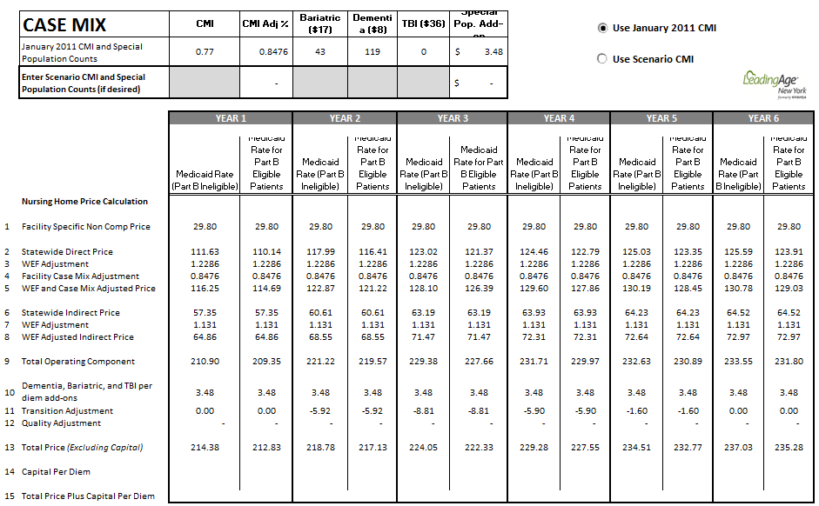
Fall 2013 Reimbursement Update
Medicaid rate estimate template:

Slide 65
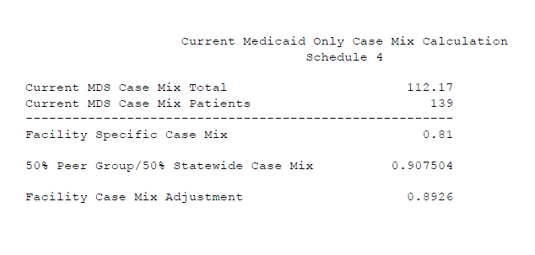
Fall 2013 Reimbursement Update
Case Mix adjustment:
Base year case mix does not change (e.g., always .907504 for free standing homes with fewer than 300 beds). Latest facility CMI (labeled “Facility Specific Case Mix” above) divided by base year statewide case mix (labeled “50% Peer Group/50% Statewide Case Mix” above) yields the “facility case mix adjustment” that is applied to the direct component used in the rate calculation.

Slide 66
Fall 2013 Reimbursement Update
M
CMI constraint in 7/1/12 rates
Nursing homes whose Case Mix Index (CMI) changed by five or more percent (from Jan 2011-Jan 2012) received initial 7/1/12 rates in which the case mix change was constrained to 5 percent. The constraint was removed and final 7/1/12 rates were issued and payments adjusted in August of 2013.

Slide 67
Fall 2013 Reimbursement Update
M
MDS Audits
First round (Jan 2012 assessment) of audits focus on homes with CMI increase of 5% or higher
All 300 homes to be audited
76 homes processed (12 % of state) by May
Of these, 21 determined to warrant rate decrease
Average rate reduction of $2.71 per day
Total savings of $3.2 million
OMIG auditing only “high risk” MDS records in first round. “High risk” is defined as an MDS record of a resident whose RUG assignment would change if one or two ADL errors were found and corrected.

Slide 68
Fall 2013 Reimbursement Update
M
MDS Audits (continued)
OMIG has selected the homes for the second round (July 2012 assessment) of audits
250 homes to be audited
Western and Northern NY as well as the Capital Region are the current (Fall 2013) audit focus
State may seek to supplement MDS audit staff by using IPRO or a temporary services contract
OMIG intends to have all January and July 2012 audits final by Feb. 2014.

Slide 69
Fall 2013 Reimbursement Update
Note: Jan 2011 and 2012 are based on DOH CMI calculations. July 2012 is calculated by LeadingAge NY and does not reflect any "surrenders“.

Slide 70
Fall 2013 Reimbursement Update
Note: Jan 2011 and 2012 are based on DOH CMI calculations. July 2012 is calculated by LeadingAge NY and does not reflect any "surrenders“.

Slide 71
Fall 2013 Reimbursement Update
M
NH Capital
DOH-convened workgroup addressing issues of NH capital and refinancing
DOH optimistic that viable solutions can be developed (e.g., establishing a pool from which plans that contract with higher capital cost homes could be reimbursed)
Other ideas being explored such as including a capital quality measurement and energy efficiency incentives

Slide 72
Fall 2013 Reimbursement Update
M
Recovery of outstanding Medicaid liabilities
The state is hoping to collect or recoup the bulk of moneys owed by providers to Medicaid by March 31, 2015.
They are offering incentives for homes to pay off rate-related balances.
Cash receipt assessment payments are NOT eligible for incentives.
Rate adjustment related balances paid by September 1, 2013 would have ALL accumulated interest waived.
Rate adjustment related balances paid by March 1, 2014 would have HALF of the accumulated interest waived.
The recoupment percentages for providers not taking advantage of the incentives may be adjusted to ensure complete repayment by March 31, 2015 (rate related and assessment balances).
The letter provides an e-mail for requesting a complete statement of your home’s liabilities and interest.
Action was required by August 16, 2013.

Slide 73
Fall 2013 Reimbursement Update
M
Bed Hold Across-the-Board Cut
Line 14 of rate sheets covering periods on and after 1/1/13 show the negative adjustment to rates from the bed hold related across-the-board cut. Amount to be adjusted 4/1/14.
DOH was directed to generate $40 million in savings in the 2012-13 state budget by reducing Medicaid bed hold payments for adult nursing home residents. Effective July 1, 2012, reimbursement for reserved bed days for each recipient is limited to 14 days in any 12-month period for hospitalizations and therapeutic leave of absences combined, and up to 10 days for “other leaves of absence.” In addition, hospitalization bed holds are paid at 50 percent of the nursing home rate, with other bed holds continuing to be reimbursed at 95 percent of the rate.

Slide 74
Fall 2013 Reimbursement Update
M
Nursing Home Bed Hold Changes
The Bed Hold DAL sets out three varieties of bed reservation days:
1. Leave of absence for temporary hospitalization (reimbursed 50 percent of Medicaid rate);
2. Leave of absence for visits to a health care professional that are expected to improve the patient’s physical condition or quality of life (95 percent of the rate); and
3. All other leaves of absence (95 percent of the rate).
The 12-month combined limit for hospitalization and health care professional leaves (numbers 1 and 2 above) is 14 days. The 12-month limit for “other” leaves of absence is 10 days (in addition to the combined 14 day limit). These changes do not apply to residents under the age of 21.
The DAL also provides new rate codes associated with each type of leave.

Slide 75
Fall 2013 Reimbursement Update
M
Universal Settlement
DOH is in the process of recalculating facility benefit estimates and draft language has been reviewed by DOH and DOB. DOH is currently discussing the settlement with the Attorney General’s office.
DOH anticipates that the settlement will benefit homes in a managed care world through benchmark rates reflected in premiums paid to managed care plans.

Slide 76
Fall 2013 Reimbursement Update
M
Quality Pool
DOH plans to implement the quality pool in 2013 by scoring and comparing facilities’ performance in the following categories:
quality measures based on MDS 3.0 data, employee flu vaccination data and the CMS Five-Star staffing measure;
compliance measures based on the CMS Five-Star health inspection rating and timely filing of Medicaid cost reports and flu immunization data; and
avoidable hospitalizations based on MDS 3.0 data and a potentially preventable hospitalization quality indicator for short and long stay hospitalizations.
Benchmark reports issued (based on previous year’s data).
Payment amounts will depend on which quintile a home is in.
Most homes should anticipate a per-day cut between $1.50 and $2.00 depending on how far their operating rate varies from state average (home with state average rate should expect a cut of $1.70 to fund the $50M quality pool)

Slide 77
Fall 2013 Reimbursement Update
M
90-Day Claiming Limit Enforcement
E-MedNY enforcing the 90 day claiming limit as of late May
Exception code 11 no longer automatic catch-all
Impacts all Medicaid providers
Medicaid eligibility determination delays a legitimate exception
Please let us know if an issue for your home

Slide 78
Fall 2013 Reimbursement Update
M
Resources
Medicaid Rate Template
  Select “Templates” sub-menu on Data Page of www.LeadingAgeNY.org
  Medicare PPS Template
  Search “PPS” on LeadingAge web site (www.leadingage.org)
Data Tools:
    LeadingAge NY FASTracker (contact dkirstein@leadingageny.org)
    Salary Report (to be distributed to participants)
    Available on LeadingAgeNY.org data page:
      Nursing home and ADHC occupancy
      Nursing home staff turnover and retention
      Medicaid beneficiaries distribution by FFS/managed care plan type
      CMI Benchmarker
  Other
    LeadingAge Financial Managers’ List Serv
    This memo which will be posted and updated periodically to serve as reference

Slide 79

Autumn leaves will be falling soon. Enjoy the season!
Patrick Cucinelli ext. 145
Darius Kirstein ext. 104
Tel. 518-867-8383
Fax 518-867-8384
pcucinelli@leadingageny.org
dkirstein@leadingageny.org

