Slide 1


Food Safety Requirements
Use and Storage of Food Brought to Residents
For All Staff
Notes:
This training is designed to provide you with an overview of the new regulations, definitions and staff roles and responsibilities with regard to food procurement and storage of food and beverage brought in for residents.

Slide 2
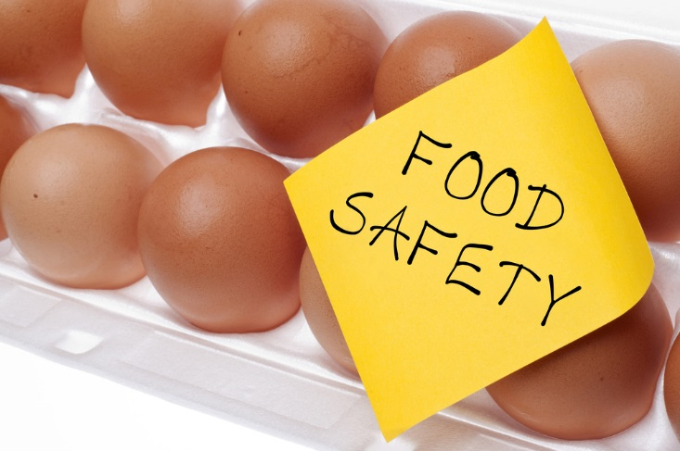
Food Safety Policy
Objectives:
Obtain a basic understanding of the new changes to the facility Food Safety Policy
Understand the role and responsibilities of the facility when visitors bring in food and beverages for the residents
Notes:
Here are the objectives of today’s training. There have been some changes to food safety requirements related to our facility as well as the food and beverages brought in by visitors and family members to our residents.

Slide 3
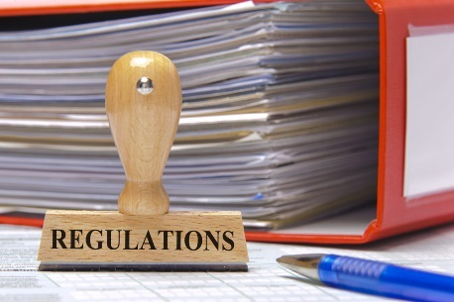
Introduction
The nursing home Requirements of Participation (RoP) are the regulations that set minimum standards for nursing homes.
The RoP were rewritten in October 2016.
The changes in regulations go into effect over the next three years, in phases.
Notes:
For the purposes of this education, we will refer to the regulations for the use and storage of food and beverages brought in for the residents and also, the rights of residents to consume items brought in by family or visitors
The regulations:
Nursing homes that accept payments from Medicare and Medicaid must meet minimum standards for the quality of the care and services they provide. Today’s training will discuss the updated federal regulations related to abuse.
The federal regulations were rewritten in 2016 for the first time since 1991 – the updates were completed in order to modernize the language and reflect changes that have happened in care, resident populations and quality standards.
The changes are being called the “Mega-Rule” because there are over 700 pages of regulations. There are three phases of implementation: Phase 1 was effective November 28, 2016, phase 2 is effective November 28, 2017 and phase 3 is effective on November 28, 2019.

Slide 4

Overview of the Regulation
Food safety requirements
The facility must
Procure food from sources approved or considered satisfactory by federal, state or local authorities.
  This may include food items obtained directly from local producers, subject to applicable State and local laws or regulations.
Notes:
Review the regulation.
New within the regulation is that facilities may now work with local producers as allowed by State and local law.
Our goals are:
(1) to prevent “Foodborne Illness” which refers to illness caused by the ingestion of contaminated food or beverages.
(2)To allow residents to consume foods brought in to the facility by family and visitors
.

Slide 5
Overview of the Regulation
Food safety requirements.
Does not prohibit or prevent facilities from using produce grown in facility gardens, subject to compliance with applicable safe growing and food handling practices
Does not preclude residents from consuming foods not procured by the facility.
Notes:
Review the regulation.
Also, the facility may grow it’s own produce in compliance with safe practices.
And, residents may consume foods brought in by family and visitors.
Our goals are:
(1) to prevent “Foodborne Illness” which refers to illness caused by the ingestion of contaminated food or beverages.
(2)To allow residents to consume foods brought in to the facility by family and visitors
.

Slide 6
Overview of the Regulation
Store, prepare, distribute and serve food in accordance with professional standards for food service safety.
Have a policy regarding use and storage of foods brought to residents by family and other visitors to ensure safe and sanitary storage, handling, and consumption.
Notes:
Review the facility policy for handling of food items brought in by visitors.
Which staff members will receive items, where will food be stored, who will label and date, who will discard items.

Slide 7

Facility Response
Understand
Inform
Limitations
Monitor
Understand
Inform
Limitations
Monitor
Notes:
Our response to these updated regulations includes:
Understand – understanding the updates to the regulations through this training and safe food handling policy. Todays training will walk us through the changes and our roles and responsibilities.
Inform – how we are informed of food and beverages brought in to the facility and inform the resident and representatives of any concerns, or actions taken to promote safe handling, sanitation and safe consumption of food/beverages
Limitations and Concerns – we will discuss how we handle any limitations and concerns
Monitor – we will monitor our policy via our QAPI program as applicable

Slide 8
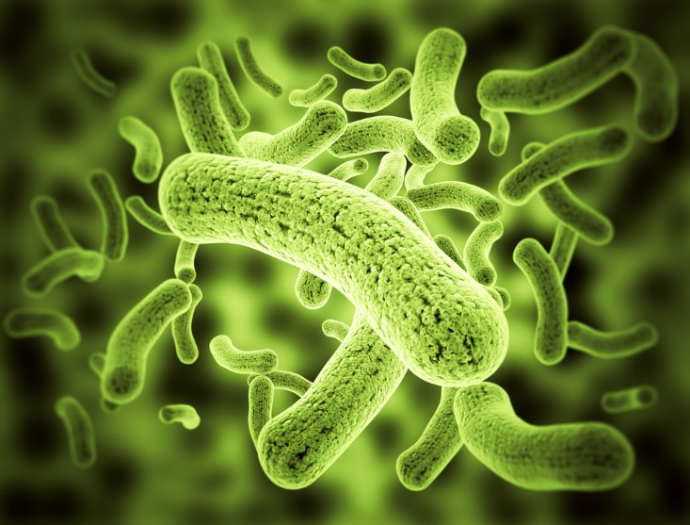
Understand - Food Safety and Sanitation
Nursing home residents risk serious complications from foodborne illness as a result of their compromised health status.
Unsafe food handling practices represent a potential source of pathogen exposure for residents. Sanitary conditions must be present in health care food service settings to promote safe food handling.
Notes:
We serve a “Highly Susceptible Population” - refers to persons who are more likely than the general population to experience foodborne illness because of their susceptibility to becoming ill if they ingest microorganisms or toxins. Increased susceptibility may be associated with immuno-compromised health status, chronic disease and advanced age.
The Food and Drug Administration’s Food Code (Section 3-801.11) includes nursing facilities in its definition of a “highly susceptible population.”

Slide 9
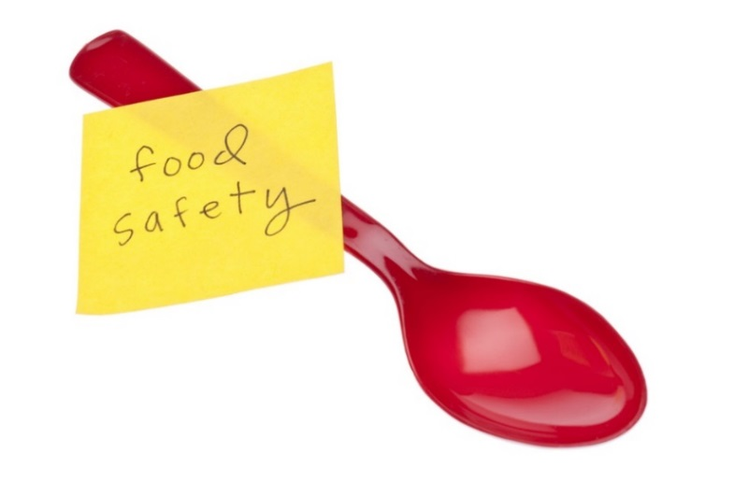
Inform - Food Safety and Sanitation
Safe food handling for the prevention of foodborne illnesses begins when food is received and continues throughout the facility’s food handling processes.
Received through the kitchen
Home grown
Brought In
Notes:
This applies to food received through the kitchen and to items brought in by family and community members.
Discuss the process of how the facility procures and brings food in –
Order process
Procurement through approved vendors
rotating stock
We have set freezer and refrigeration policies and processes
Infection control is a must!
Home grown
Facility staff will follow applicable State and local laws or regulations with respect for obtaining food items directly from local producers. (Insert state specific information here)
Facility gardens will be conducted in accordance with applicable safe growing and food-handling practices. (Insert facility specific information here)
Brought In
we have a set policy and process on how we handle food and beverages being brought in to our residents – safety and infection control are key

Slide 10

Inform - Food Safety and Sanitation
Insert P&P template for food safety requirements for food/beverages brought in
Notes:
We have a set policy on how we work with residents, families and visitors as they bring in food and beverages for our residents. It is our residents right to have these items brought in and it is our responsibility to aide the resident with safe food storage, handling, sanitation and safe consumption
Food And Beverage Brought In For Residents
Resident Individualized Assessment and Comprehensive Care Planning
Upon admission, readmission and as needed residents will be assessed as to their abilities around consumption and safe handling and storage of food and beverages via the resident assessment instrument and correlating processes.
Notification of assessment outcomes will be provided to resident, resident representative, primary care physician and others as applicable. Care plan will be updated as applicable.
Educate and Inform
Educate staff, family, residents, visitors and community groups on resident’s right to consume foods not procured by the facility on admission, readmission and as needed.
Education on safe food handling will be provided to all staff, family, residents, resident council, visitors and community groups who may provide foods or fluids to residents of the facility. This education will include at a minimum:
Proper food handling to prevent foodborne illness
Perishable food such as meat, poultry, fish, and dairy products must be frozen or refrigerated immediately after receipt.
Requirements for covered containers or secure wrapping
Proper labeling and dating of each item
Leftover foods will be used within 3 days or discarded
All refrigerators will be at or below 41 degrees F, freezers will be cold enough to keep foods frozen solid to the touch.
Leftovers will be reheated to 165 degrees.
Method for checking proper food temperature
Monitor
Facility staff will be appointed to check resident refrigerators for proper temperatures, food containment and quality, and disposal of items per facility policy. (Insert facility specific information here)
Facility staff will be appointed to check resident rooms through daily housekeeping process for food and beverage items for safe and sanitary storage and handling (Insert facility specific information here)
Foods requiring refrigeration will be received by the facility designee (activity department, food and nutrition department, charge nurse, etc.) (Insert facility specific information here) for proper and immediate storage including labeling and dating.
Staff will examine food for quality (smell, packaging, appearance) to identify potential concerns. If concerns are identified, staff will notify the resident or resident representative of findings and necessary actions per proper food and beverage safe handling.

Slide 11

Prevention of Food Borne Illness
Hand washing
Employee health
Proper food temperatures during preparation and storage
Notes:
Hand Washing, Gloves, and Antimicrobial Gel Since the skin carries microorganisms, it is critical that staff involved in food preparation consistently utilize good hygienic practices and techniques. Staff should have access to proper hand washing facilities with available soap (regular or anti-microbial), hot water, and disposable towels and/or heat/air drying methods. Antimicrobial gel (hand hygiene agent that does not require water) cannot be used in place of proper hand washing techniques in a food service setting.
The appropriate use of utensils such as gloves, tongs, deli paper and spatulas is essential in preventing foodborne illness. Gloved hands are considered a food contact surface that can get contaminated or soiled. Failure to change gloves between tasks can contribute to cross-contamination. Disposable gloves are a single use item and should be discarded after each use. NOTE: The use of disposable gloves is not a substitute for proper hand washing with soap and water.
Personal Hygiene - Employee health and hygiene are significant factors in preventing foodborne illness. This has been demonstrated in the population at large3 , commercial food service establishments4 , and in nursing facilities5 . Foodborne illness in nursing homes has been associated with Norovirus. Because "infectious” individuals (persons capable of transmitting an infection or communicable disease whether they be colonized or infected) are a source of Norovirus, proper hand washing techniques and exclusion of infectious workers from handling food are critical for prevention of foodborne illness.
Employee Health Employees who handle food must be free of communicable diseases and infected skin lesions. (See the requirement at 42 CFR 483.80) regarding preventing the spread of infection.) Bare hand contact with foods is prohibited.

Slide 12

Inform – Residents and Representatives
Verbally or in writing
Included
  Which staff members to give food and beverage to for storage
  Proper food labeling and dating
  Proper food handling
  Resident right to consume food and beverages brought in by family and visitors
Notes:
The facility will inform residents orally and in writing of their right to bring food and beverages into the facility
Education will be provided on:
Who to give the items to for storage
Proper food labeling and dating with date received
Proper food handling to prevent foodborne illness
Maintenance of all refrigerators at 41 degrees or cooler
Maintenance of all freezers cold enough to keep foods frozen solid to the touch

Slide 13

Staff - Your Role and Responsibility
Inspect containers for tight fitting lids
Label container with food item name and date
Place in refrigerator or freezer immediately to keep foods out of the temperature danger zone of 41-135 degrees
Report refrigerator temperatures above 41 degrees
Notes:
Food Receiving and Storage When food is brought into the nursing home, inspection for safe transport and quality upon receipt and proper storage helps ensure its safety. Keeping track of when to discard perishable foods and covering, labeling, and dating all foods stored in the refrigerator or freezer is indicated.
Any employee of this facility who receives a food or beverage from a family member or visitor will affix a label on the container identifying the food item and the date it was placed into the refrigerator or freezer.
Items will be stored in designated facility refrigerators or in resident room refrigerators.
Container will be inspected to assure it is intact and seals tightly.
Wrapped items will be inspected to assure the wrapping seals tightly.
Refrigerator temperatures will be monitored per facility policy
Staff will be trained on proper refrigerator temperatures of 41 degrees or lower
Staff will be trained on appropriate steps to take if temperatures should rise above 41 degrees.
“Danger Zone” refers to temperatures above 41 degrees Fahrenheit (F) and below 135 degrees F that allow the rapid growth of pathogenic microorganisms that can cause foodborne illness. Potentially Hazardous Foods (PHF) or Time/Temperature Control for Safety (TCS) Foods held in the danger zone for more than 4 hours (if being prepared from ingredients at ambient temperature) or 6 hours (if cooked and cooled) may cause a foodborne illness outbreak if consumed.

Slide 14
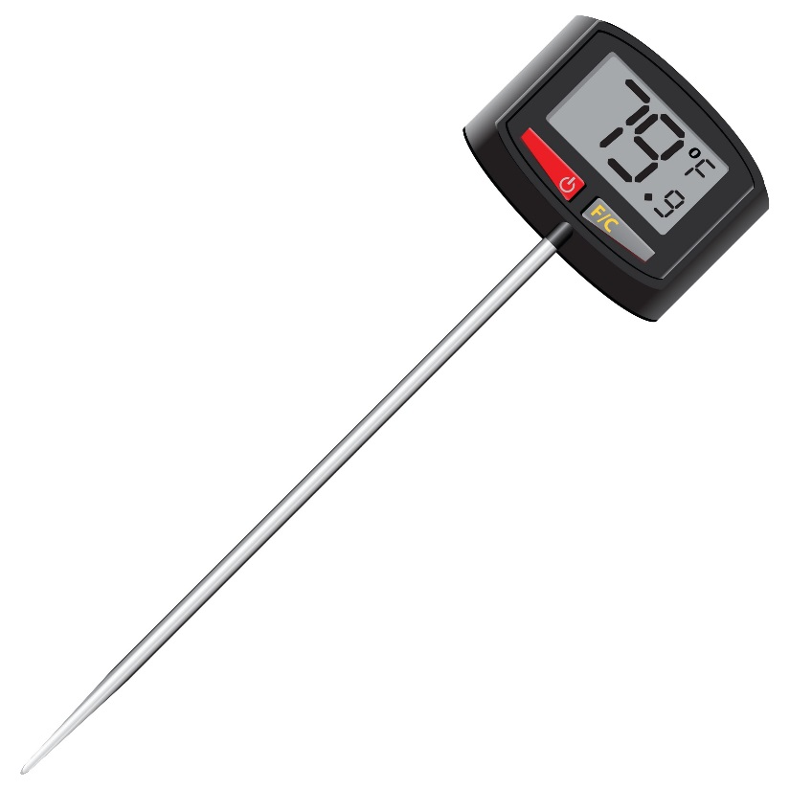
Staff – Your Role and Responsibility
No bare hand contact with “ready to eat food” including bread, peeled bananas, hard boiled eggs, cookies, etc.
Follow facility policy when reheating leftovers to 165 degrees for holding.
Ready-to-eat foods must be heated to at least 135 degrees for holding.
Notes:
“Ready-to-Eat Food” refers to food that is edible with little or no preparation to achieve food safety. It includes foods requiring minimal preparation for palatability or culinary purposes, such as mixing with other ingredients (e.g., meat type salads such as tuna, chicken, or egg salad).
Reheating Foods - Reheated cooked foods present a risk because they have passed through the danger zone multiple times during cooking, cooling, and reheating. The PHF/TCS food that is cooked and cooled must be reheated so that all parts of the food reach an internal temperature of 165 degrees F for at least 15 seconds before holding for hot service. Ready-to-eat foods that require heating before consumption are best taken directly from a sealed container (secured against the entry of microorganisms) or an intact package from an approved food processing source and heated to at least 135 degrees F for holding for hot service.

Slide 15
Limitations
Resident has specific behaviors that contradict safe handling, storage or consumption
Family or visitors do not understand clinical or other factors
Resident refusal of dietary restrictions
Resident likes to leave food out that requires refrigeration
Others
Notes:
Discuss how to handle road blocks or limitations for the resident, family, visitor that may pose an unsafe situation

Slide 16
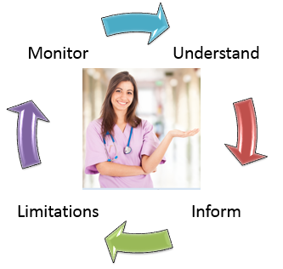
Monitor
Food Audit
New and Re-Admissions
Resident Interviews
Family Interviews
Resident Council
Housekeeping logs
Problem/Concern Process
Observations
QAPI
Notes:
As always, with every system, there needs to be a monitoring process in place.
Discuss current process, thoughts on the slide
Incorporate findings into the QAPI process.

Slide 17
Summary
Understand
Inform
Limitations
Monitor
Understand
Inform
Limitations
Monitor
Notes:
Summarize with the group
Our response to these updated regulations includes:
Understand – understanding the new regulations and our Food Safety review policy. Todays training addressed the regulatory changes and our roles and responsibilities.
Inform – how we will inform the resident, family and visitors of the regulations as it relates to bringing food into the facility to ensure that they are labeled, handled and stored within the regulatory requirements
Limitations and Concerns – we have discussed some limitations and concerns and how good systems and communication will continue to meet the quality needs of our residents with food safety, procurement, handling, storage and delivery of safe food.
Monitor – we will monitor our policy via our QAPI program as applicable

Slide 18

Questions?
Resources:
"SOM - Appendix PP." SOM - Appendix PP. CMS, n.d. Web. https://www.cms.gov/Medicare/Provider-Enrollment-and-Certification/SurveyCertificationGenInfo/Downloads/Survey-and-Cert-Letter-17-07.pdf

Slide 19
Thank you for participating in this education session!

