Slide 1



Bed Rail Use and Bed Inspection
Training for Health Care Workers

Slide 2
Objectives
Understand the regulations that guide bed rail use
Identify the FDA’s seven zones of potential entrapment
Identify risks and benefits of bed rail use
Identify components of bed system inspection
Identify components of resident risk assessment
Notes:
The purpose of this lesson is to educate health care workers about the risks and benefits of utilizing bed rails and other devices for safety on bed systems

Slide 3

Introduction
The nursing home Requirements of Participation (RoP) are the regulations that set minimum standards for nursing homes.
The RoP were rewritten in October 2016.
The changes in regulations go into effect over the next three years, in phases.
There were changes made to the regulations for bed rails and inspections of bed frames, mattresses and bed rails.
Notes:
For the purposes of this education, we will refer to the regulations for Bed Rail Use and the new Bed Inspection protocols.
The federal regulations were rewritten in 2016 for the first time since 1991 – the updates were completed in order to modernize the language and reflect changes that have happened in care, resident populations and quality standards.
The changes are being called the “Mega-Rule” because there are over 700 pages of regulations. There are three phases of implementation: Phase 1 was effective November 28, 2016, phase 2 is effective November 28, 2017 and phase 3 is effective on November 28, 2019.
Today we will review the changes made to the regulations related to resident safety – specifically bed rails, bed inspections and bed safety.

Slide 4
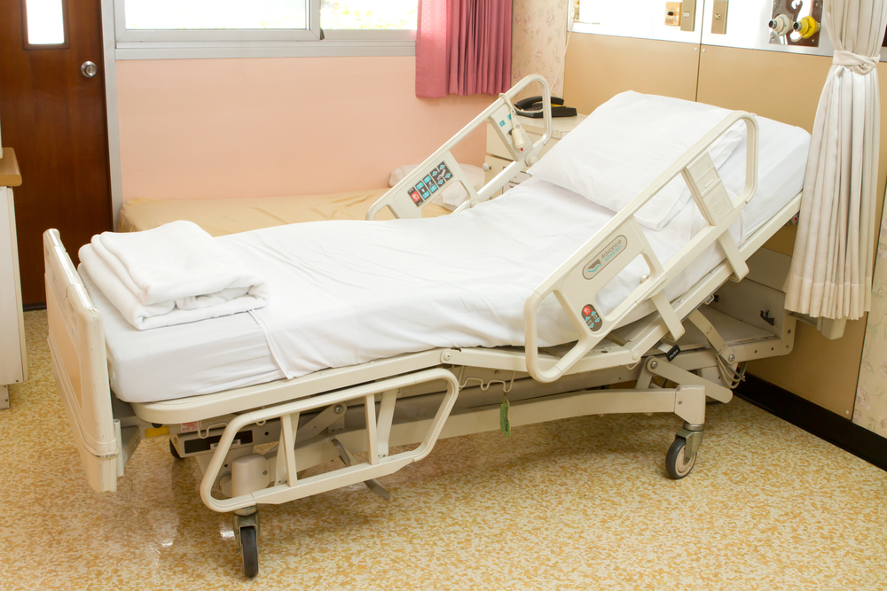
Overview of the Regulation
The facility must attempt to use appropriate alternatives prior to installing a side or bed rail. If a bed or side rail is used, the facility must ensure correct installation, use, and maintenance of bed rails, including but not limited to the following elements.
  (1) Assess the resident for risk of entrapment from bed rails prior to installation
  (2) Review the risks and benefits of bed rails with the resident or resident representative and obtain informed consent prior to installation.
  (3) Ensure that the beds dimensions
  are appropriate for the resident’s
  size and weight.
Notes:
New Regulations and Updates to Bed Rails and Bed Inspection –
The intent of this regulation is to ensure that the facility provides an environment that is free from accident hazards over which the facility has control and provides supervision and assistive devices to each resident to prevent avoidable accidents.
Our goal is to reduce potentially life-threatening entrapments associated with bed systems.

Slide 5
Overview of the Regulation
Follow the manufacturers recommendations and specifications for installing and maintaining bed rails.
Conduct Regular inspection of all bed frames, mattresses, and bed rails, if any, as part of a regular maintenance program to identify areas of possible entrapment.
When bed rails and mattresses are used and purchased separately from the bed frame, the facility must ensure that the bed rails, mattress, and bed frame are compatible.
Notes:
Discuss manufacturers recommendations – give an example.
Group Discussion – what is a bed inspection? When should a bed inspection be completed? Who is responsible to complete the inspection?
Why is it important to use bed rails correctly?
Our Policy states - It is the policy of this facility to identify and reduce safety risks and hazards commonly associated with bed rail use. A dual-faceted approach will be used to achieve sustainable quality outcomes, including 1) regular bed maintenance and 2) individual bed rail evaluations. In response to the requirement of providing for a “safe, clean, comfortable, and homelike environment,” the facility’s regular maintenance program will include regular inspection of all bed systems (e.g. rails, frames, and mattresses, and operational components) to ensure they are clean, comfortable, and safe.

Slide 6
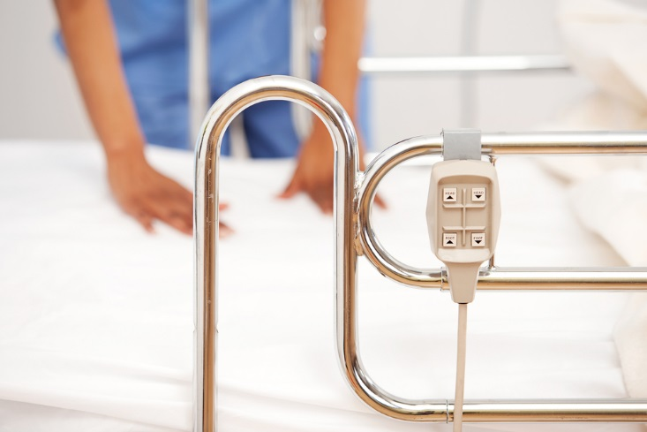
Definitions
Assistance Device or Assistive Device refers to “Any item (e.g., fixtures such as handrails, grab bars, and devices/equipment such as transfer lifts, canes, and wheelchairs, etc.) that is used by, or in the care of a resident to promote, supplement, or enhance the resident’s function and/or safety. “
Bed/Side Rails” refers to “A physical
device attached to the resident’s
bed intended to enable turning
or repositioning”
Notes:
Regardless of the purpose for use, bed rails (also referred to as “side rails, ”bed side rails, "and “safety rails”) and other bed accessories (e.g., transfer bar, bed enclosures), while assisting with transfer and positioning, can increase resident safety risk.
Bed rails include rails of various sizes (e.g., full length rails, half rails, quarter rails) that may be positioned in various locations on the bed.
According to CMS Bed rails (also referred to as “side rails,” “bed side rails,” and “safety rails”) are constructed of metal or rigid plastics, and are available in various sizes (e.g., full length rails, half rails, quarter rails), to align with resident-specific needs. Bed rails may be positioned in various locations on the bed; upper or lower, either or both sides.

Slide 7

Background
In 2006 the Food and Drug Administration (FDA) issued a safety alert regarding potential hazards with hospital beds and hospital bed accessories.
Some bed systems carry a risk of:
  Severe injury
  Strangulation
  Asphyxiation
  Serious injury
  Death
Notes:
FDA received approximately 691 entrapment reports over a period of 21 years from January 1, 1985, to January 1, 2006⁹. In these reports, 413 people died, 120 were injured, and 158 were near-miss events with no serious injury as a result of intervention. These entrapment events have occurred in openings within the bed rails, between the bed rails and mattresses, under bed rails, between split rails, and between the bed rails and head or foot boards.
Entrapments have occurred in a variety of patient care settings, including hospitals, nursing homes, and private homes. Long-term care facilities reported the majority of the entrapments.
The term “hospital bed” refers to a variety of medical devices that are classified as beds including those used in long term care, acute care or home care settings.
Some beds are excluded from this guidance including air fluidized therapy beds, bariatric beds, and stretchers.

Slide 8
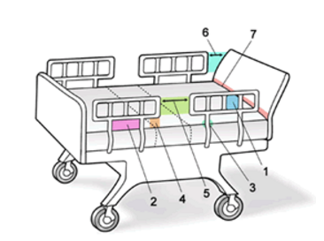
FDA 7 Zones of Entrapment
Source: US Food and Drug Administration Bed Syst4em Dimensional and Assessment Guidance
http://www.fda.gov/RegulatoryInformation/Guidances/ucm072662.htm#8
Notes:
Zone 1: Within the Rail
Zone 2: Under the Rail, Between the Rail Supports or Next to a Single Rail Support
Zone 3: Between the Rail and the Mattress
Zone 4: Under the Rail, at the Ends of the Rail
Zone 5: Between Split Bed Rails
Zone 6: Between the End of the Rail and the Side Edge of the Head or Foot Board
Zone 7: Between the Head or Foot Board and the Mattress End
The FDA provides dimensional recommendations for Zones 1-4, as 80% of reported entrapment cases have occurred in these zones.
Group Discussion: Discuss why these zones are important to know

Slide 9
Potential Zones of Entrapment
Space or gap must be less than 4 ¾ inches
  Within the rail
  Under the rail, between the rail supports
  Between the rail and mattress
Space or gap must be less than 2 ¾ inches
  Under the rail at the end of
  the rail, between the rail and
  the mattress
Notes:
Also:
ZONE 5: Between Split Bed Rails
When partial length head and split rails are used on the same side of the bed, the space between the rails may present a risk of either neck or chest entrapment.
ZONE 6: Between the End of the Rail and the Side Edge of the Head or Foot Board
A gap between the end of the bed rail and the side edge of the headboard or footboard can present the risk of resident entrapment.
ZONE 7: Between the Head or Foot Board and the End of the Mattress
When there is too large of a space between the inside surface of the headboard or footboard and the end of the mattress, the risk of head entrapment increases.

Slide 10

Those at Most Risk of Entrapment
Frail or elderly
Conditions such as agitation, delirium, confusion, pain, uncontrolled body movements, hypoxia, fecal impaction, acute urinary retention
Any other condition that may cause a person to move about the bed or try to exit from the bed
Those with needs regarding toileting, positioning, and other basic care needs that may not be met timely
Notes:
As we review the potential situations, diagnosis, physical ailments as well as cognitive conditions that can [place individuals at risk, we also need to understand that every person is potentially at risk for an entrapment.
Discuss with Group other Conditions that pose a risk of entrapment

Slide 11
Key Body Parts at Risk of Entrapment
Head
Neck
Chest
Notes:
Ask group –
What body parts pose the highest risk for entrapment? (click for answers)
As we review the potential situations, diagnosis, physical ailments as well as cognitive conditions that can [place individuals at risk, we also need to understand that every person is potentially at risk for an entrapment. This is due to Key Body Parts at Risk – Three key body parts at risk for life-threatening entrapment in the seven zones of a hospital bed system discussed in this guidance are the head, neck, and chest.
Additionally our beds and potential equipment attached to the bed (Side rails and enablers) pose a high risk for all residents.

Slide 12
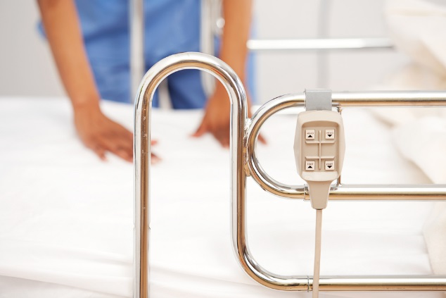
Potential Benefits of Side Rails
Enabler or repositioning aid which may:
Potentially lead to reduced risk of pressure ulcers
And reduced risk of complications of immobility and prolonged bed rest
Aligning in the turning and repositioning within a bed allowing for greater independence
Notes:
Discussion:
When and Why would we use a side rail in our facility?
Do we need to assess the resident prior to using a side rail? – Admission, Readmission, PRN, Annually?

Slide 13

Potential Safety Risks
Entrapment – most notable to the neck, head, chest and limbs
Physical restraint
Improper installation
Inappropriate location or position of bed rail
Notes:
In addition to entrapment, restraint as seen on the slide – it is important to understand that we need to weigh the risks and benefits of devices (side rails) in achieving resident outcomes.
The 1995 FDA issued Safety Alert entitled, “Entrapment Hazards with Hospital Bed Side Rails” notes the frail or elderly who have conditions such as agitation, delirium, confusion, pain, uncontrolled body movement, hypoxia, fecal impaction, acute urinary retention, etc., have an increased likelihood of entrapment. The increased risk is largely due to unsafe moving about the bed, or ill-advised attempting to exit from the bed.
In addition, the FDA Hospital Bed System Dimensional and Assessment Guidance to Reduce Entrapment, dated March 10, 2006: http://www.fda.gov/RegulatoryInformation/Guidances/ucm072662.htm provides additional guidance and recommendations that are related to both hospital beds and hospital bed accessories with recommendations that are intended to reduce life threatening entrapments.
Additionally, untimely responses to care needs, (e.g. toileting, repositioning, pain management, etc.) increases the risk of entrapment.
No matter the purpose for use, bed rails and other bed accessories (e.g., transfer bar, trapeze, bed enclosures), although prescribed to improve functional independence with bed mobility and transfers, can increase resident safety risk.
Thus, weighing the risks and benefits of devices (including bed rails) is integral to achieving positive resident outcomes.

Slide 14

Potential Regulatory Issues
Devices may be deemed a physical restraint:
“Physical restraint is any manual, physical, or mechanical device, material, or equipment attached or adjacent to the resident’s body that the resident cannot remove easily, which restricts freedom of movement or normal access to one’s body”
Notes:
As we have discussed - there are many risks or potential dangers to residents related to bed rails, assistive devices and ill fitting equipment – there are also other regulatory potentials to the facility as a result of an ineffective bed rail and bed inspection policy.
One is the potential of a bed rail or device being considered a physical restraint
Give Example

Slide 15
Potential Regulatory Issues
Entrapment related injuries or even death
Predisposition to falls or other safety hazards
Potential Impact on Quality Measures:
  Restraints
  Falls
  Injury
  Pain
Notes:
Falls do not constitute self-injurious behavior or a medical symptom that warrants the use of a physical restraint. Although restraints have been traditionally used as a fall prevention approach, they have been found to have serious drawbacks that can contribute to serious injuries.
There is no evidence that the use of physical restraints, including but not limited to side rails will prevent or reduce falls. Additionally, falls that occur while a person is physically restrained often result in more severe injuries such as strangulation and entrapment.

Slide 16
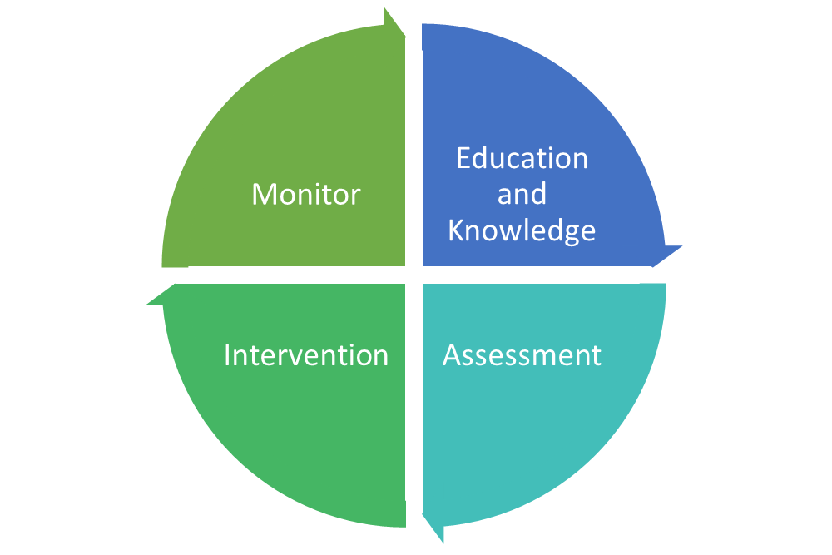
Facility Response
Knowledge
Assessment
Intervention
Monitor
Notes:
How we prepare and how we respond is key for our residents safety.
The first thing we can do is to increase our knowledge, that is Knowledge and understanding of the benefits and the risks/dangers of bed rails, the 7 zones as well as the right equipment (Manufacturers guidelines). Also it is the knowledge of our individual roles related to bed rails, devices and appropriate mattresses/bed equipment as we discussed earlier.
Next comes resident assessment.

Slide 17
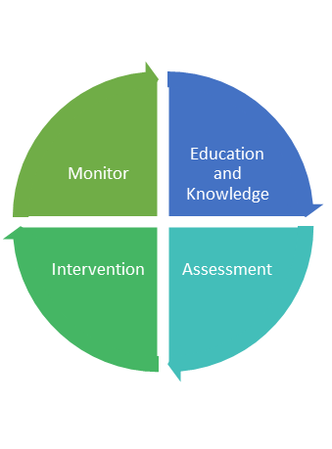
Assessing Resident Risk
Cognitive Status
Functional Status
Other Internal Risk Factors
Procedure
  Complete the risk assessment
  Implement appropriate person-centered interventions
  If bed rail used, obtain physician order
  Provide staff and resident education on device
  Update the care plan
Notes:
Cognitive Status:
Level of comprehension, Ability to follow direction, Willingness to cooperate, agitation, delirium, confusion, or pain noted?, Are basic care needs met?
Functional Status:
Upper and lower body strength, trunk strength, fine motor or hand grasp skills, demonstrates the ability to raise and lower side rails upon command and without difficulty
Also:
Identify whether the resident experiences problems at night such as memory, visual or spatial perception issues, incontinence, pain, uncontrolled body movement, hypoxia, pressure ulcers and bed mobility, or safe ambulation that may need to be addressed.
Ensure that all underlying medical problems that affect resident symptoms are addressed and treated when appropriate. Treatments must also be evaluated for effect and impact on resident comfort and safety.
Review resident’s urinary and bowel elimination patterns if indicated.
Review resident sleep patterns and life-long late night habits
Review dosages and types of medications, especially hypnotics, pain treatments, medications that create orthostatic hypotension, diuretics, and hypoglycemic medications that might be causing hunger at night.
Conduct an environmental assessment to determine whether light levels, room temperature, obstacles and mobility hazards, or other unique resident needs are impacting sleep.
Physician Order:
Type of device, specific reason for use (medical symptom) –not to keep resident in bed, duration of the application of the device

Slide 18
Bed Rail Assessment
Discuss bed rail assessment
Roles and responsibilities for completion
How assessment and interventions are implemented

Slide 19
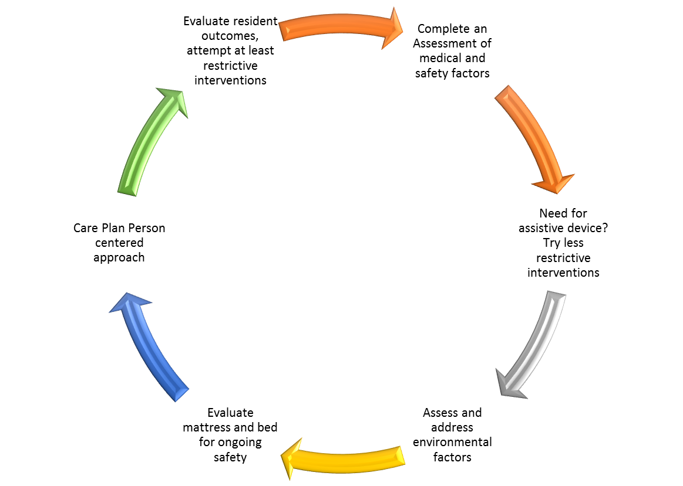
Process
Notes:
Discussion – this is not all inclusive the diagram is meant to initiate group discussion related to roles and responsibilities

Slide 20
Bed Inspection
Discuss bed inspection process and why this process is important for resident safety
Roles and responsibilities for completion

Slide 21

Interventions to Reduce Risk
Meet basic needs
Use alternatives to bed rails for positioning
Follow manufacturer guidelines regarding compatibility of mattresses, rails and accessories.
Know seven zones of entrapment and audit for risk
Staff, resident, and representative education
Notes:
Meet basic needs:
Toilet resident timely, reposition resident often, manage pain,
Repositioning alternatives:
Halo bar, trapeze
Manufacturer Guidelines:
Each manufacturer has specifications and recommendations for proper use, use only compatible devices on the beds (Example: We have two different kinds of beds in the house and each bed has a different kind of rail that is used)
Sometimes representatives and/or loved ones ask or demand that we use side rails to keep the resident from falling out of bed, we must educate them on the risk versus the benefit. If bed rails are used obtain informed consent from the resident/representative with risk and benefit information

Slide 22
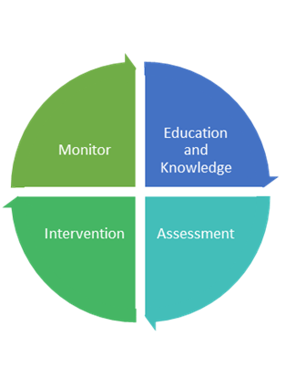
Monitor for Effectiveness
Modify interventions when necessary
Update the plan of care as needed
Perform regular bed inspection audits
Provide ongoing education
Incorporate findings into the QAPI process as indicated
Notes:
Utilize bed inspection policy to assist with proper auditing

Slide 23

Thank you for participating in this education session!
Notes:
Resource - Hospital Bed System Dimensional and Assessment Guidance to Reduce Entrapment." Hospital Bed System Dimensional and Assessment Guidance to Reduce Entrapment. FDA, n.d. Web. 17 Jan. 2017.
http://www.fda.gov/RegulatoryInformation/Guidances/ucm072662.htm#7

